Slide 1


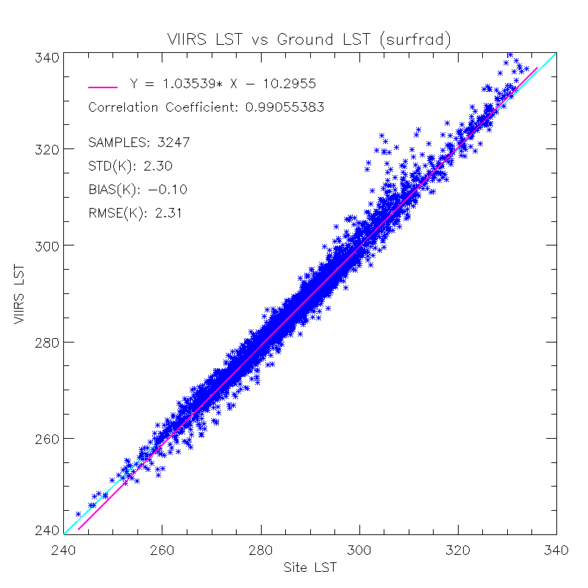
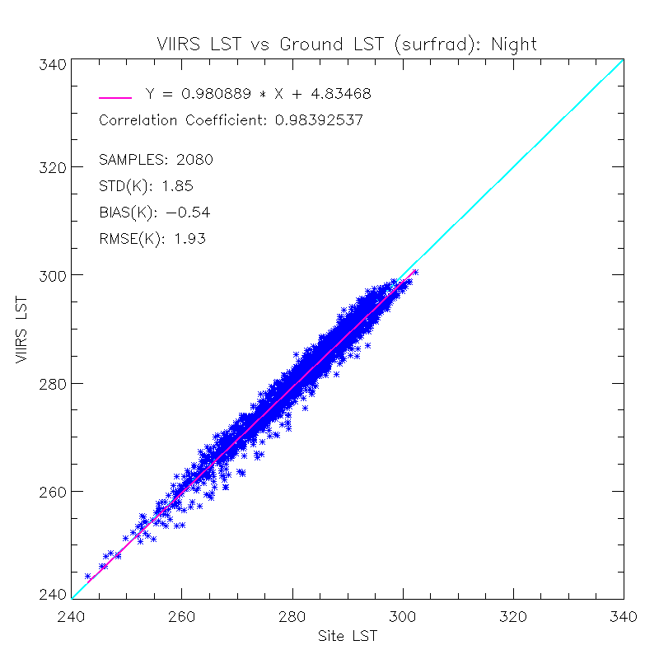
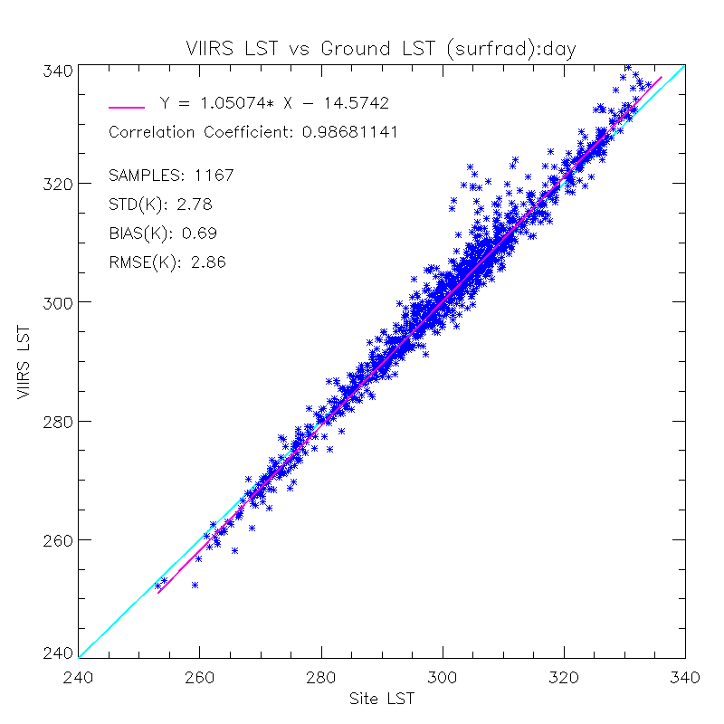
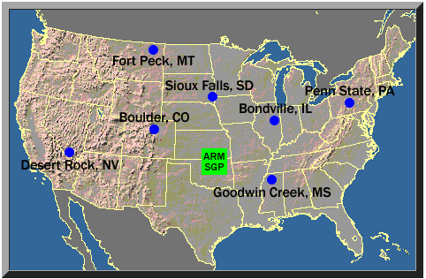
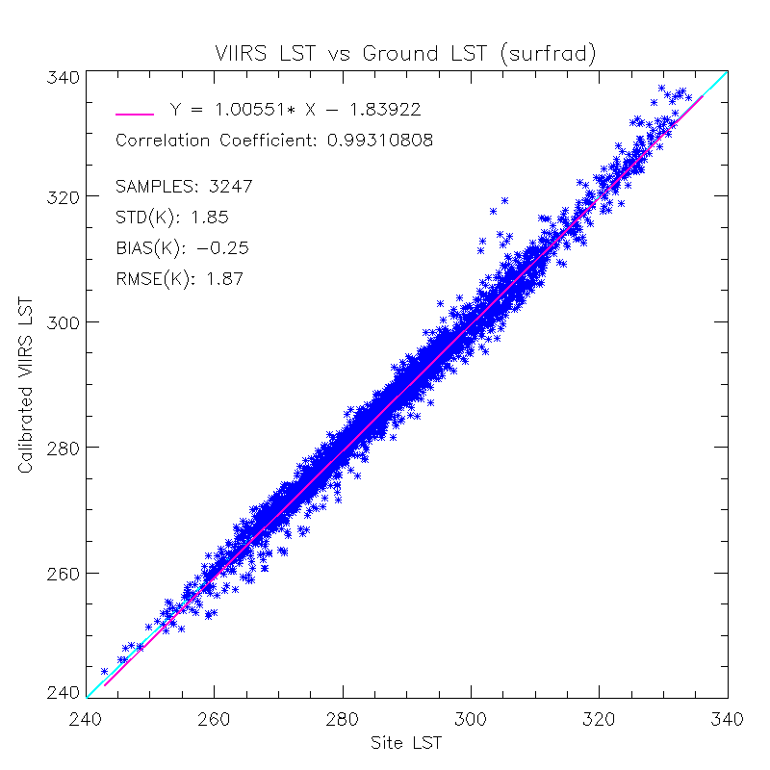
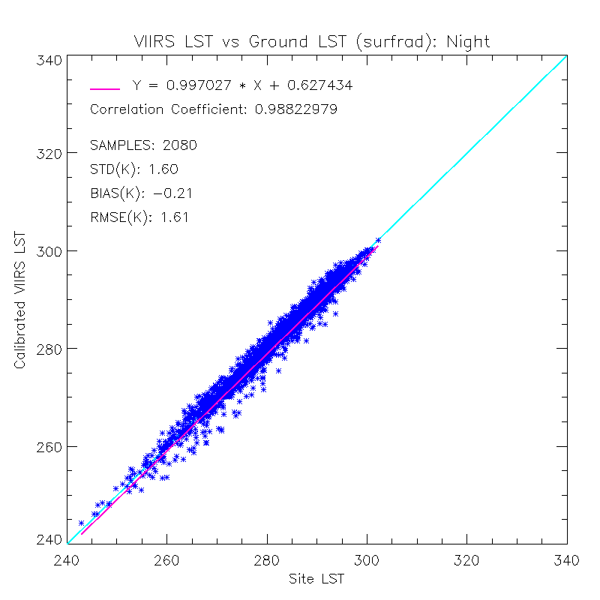
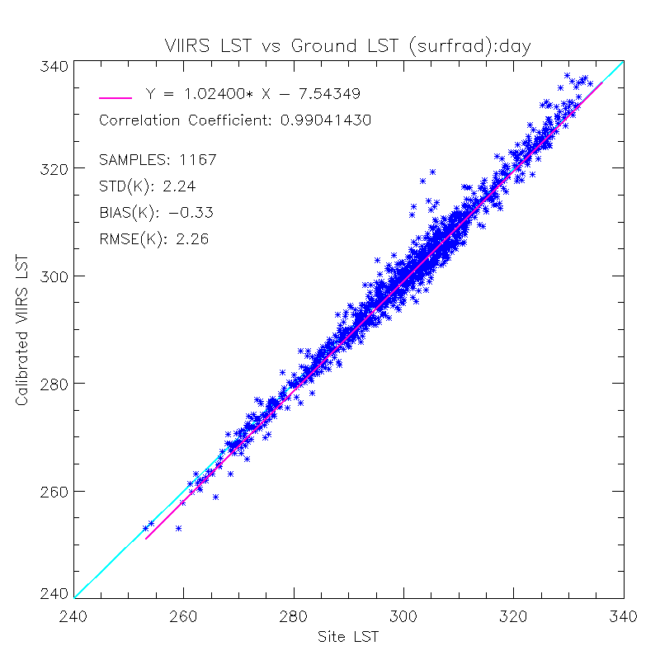
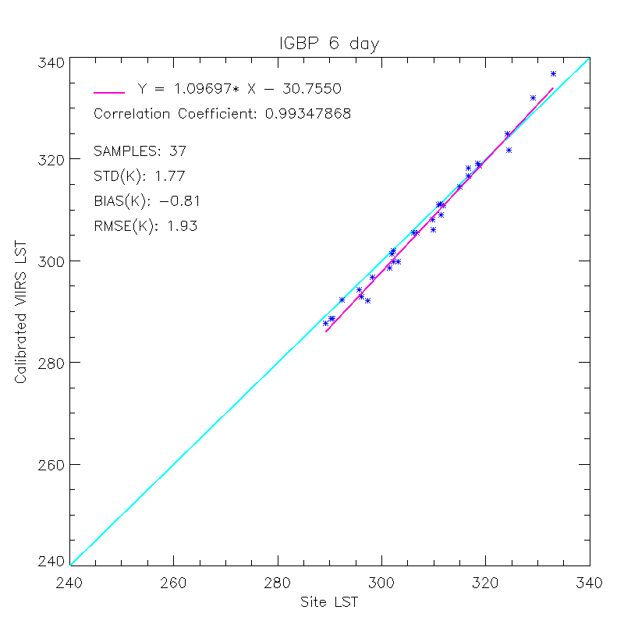
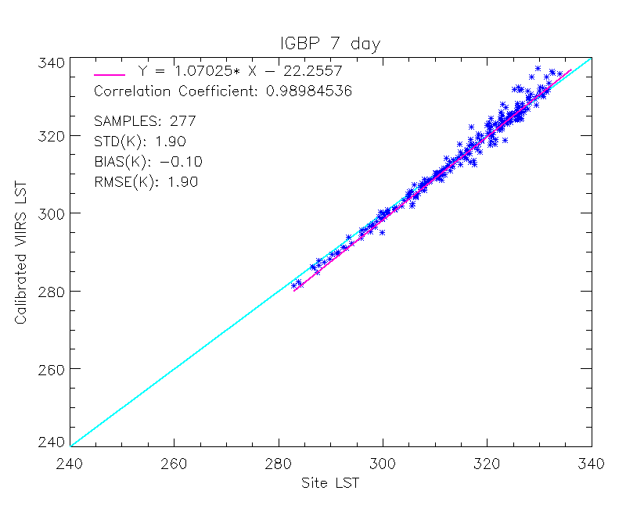
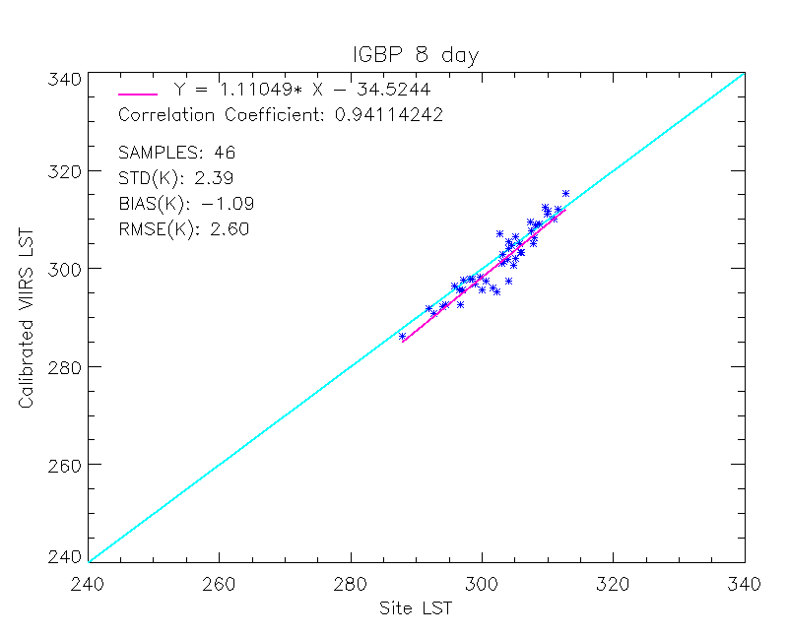
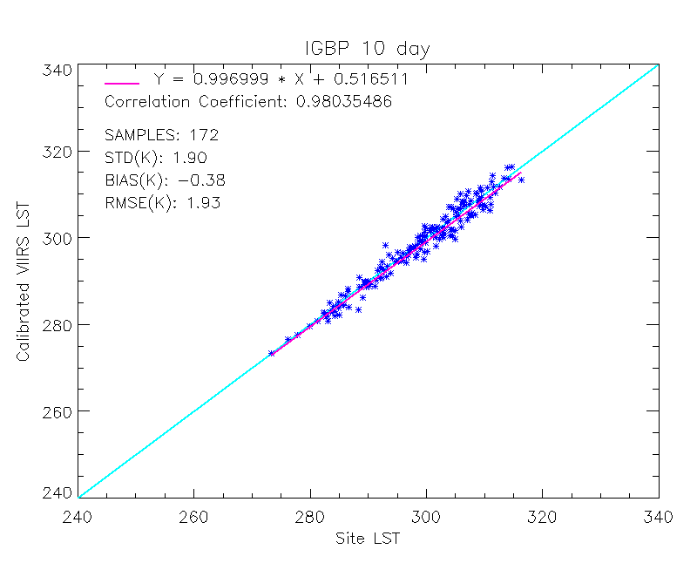
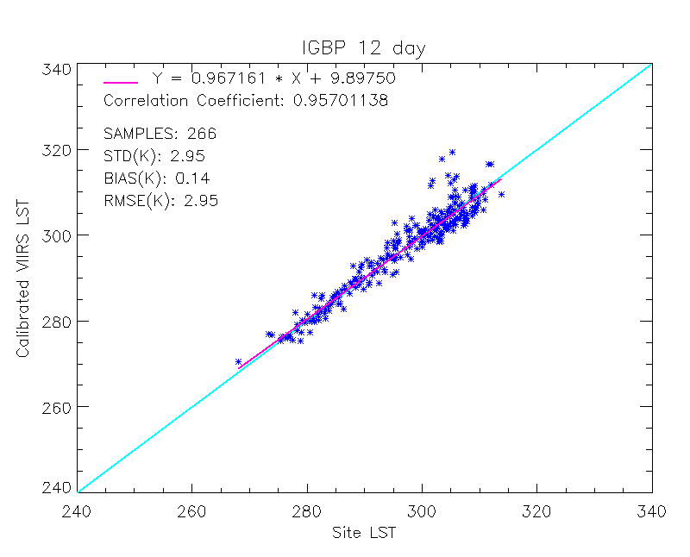
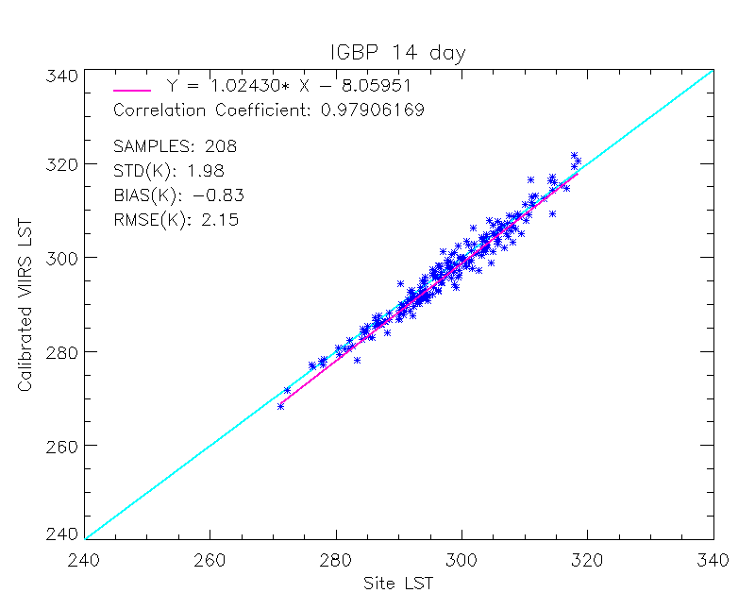
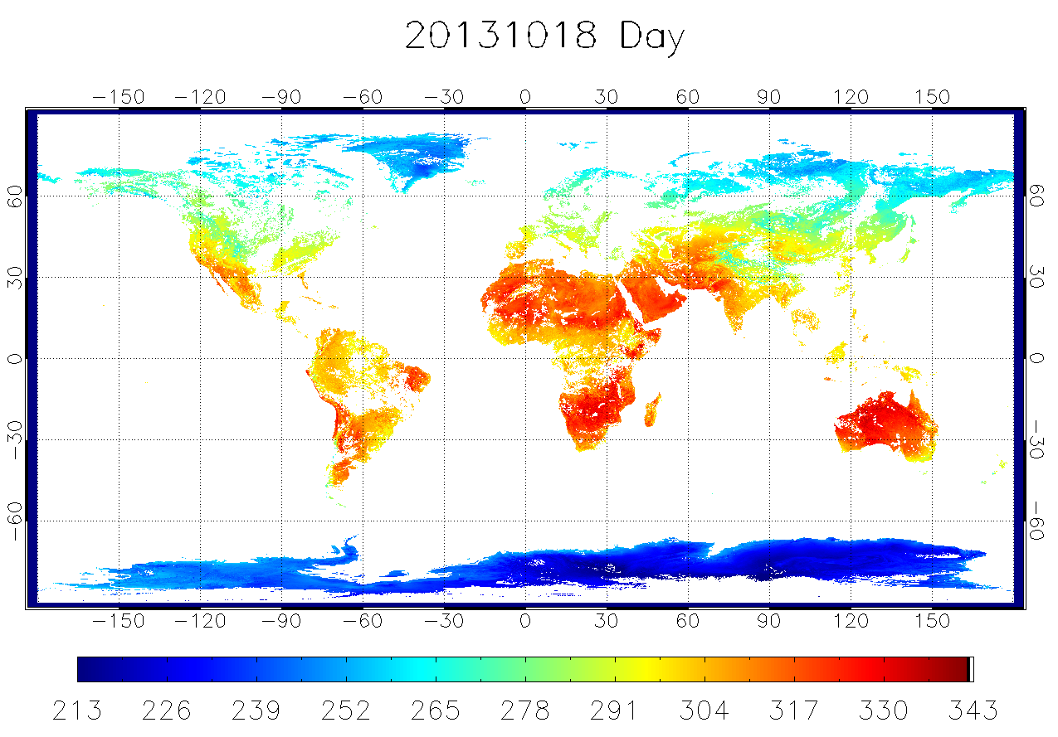
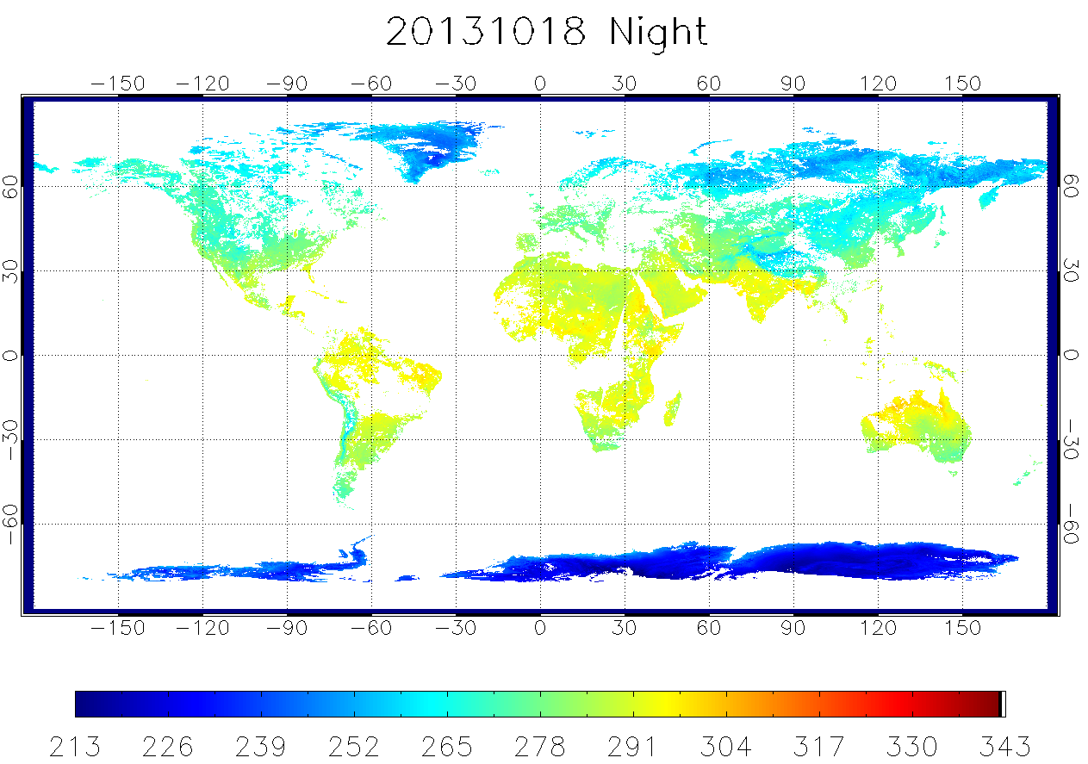
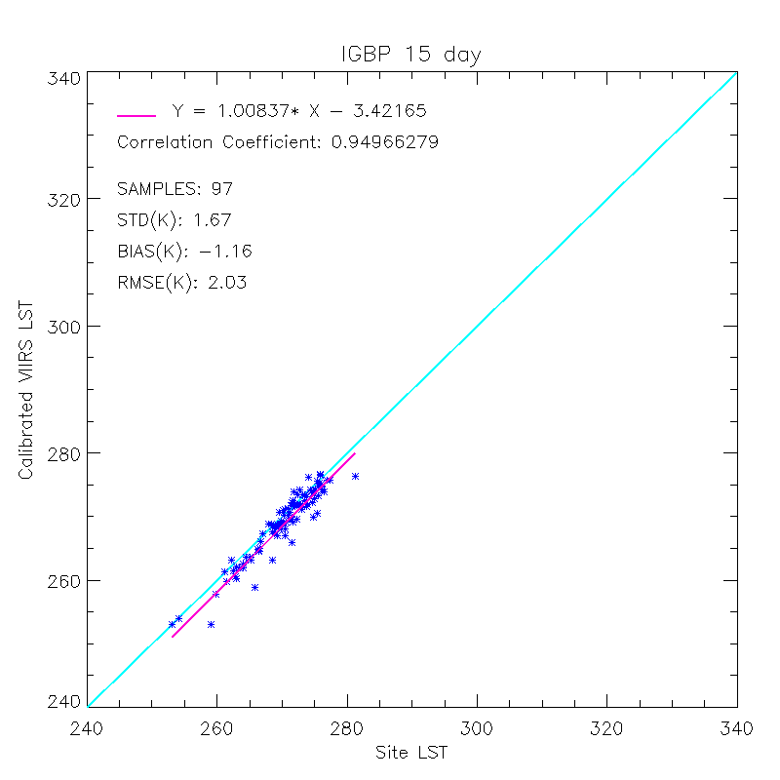
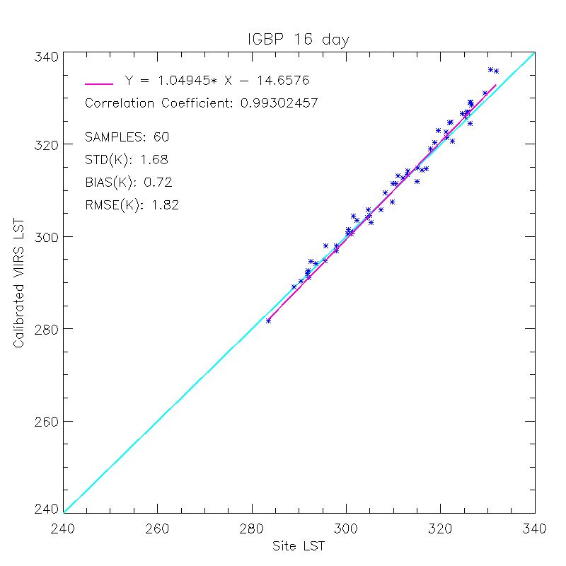
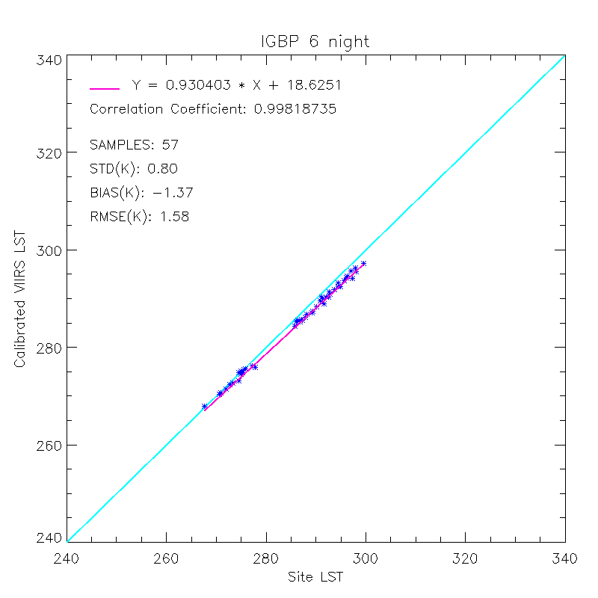
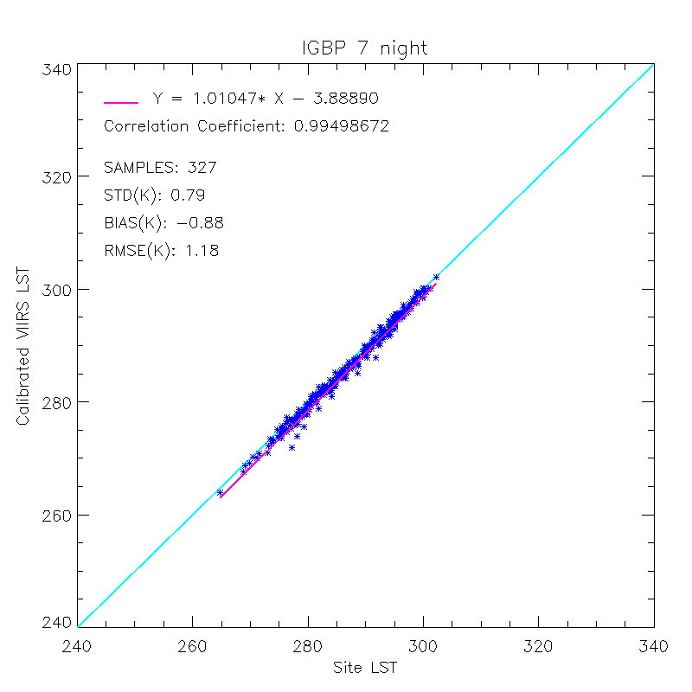
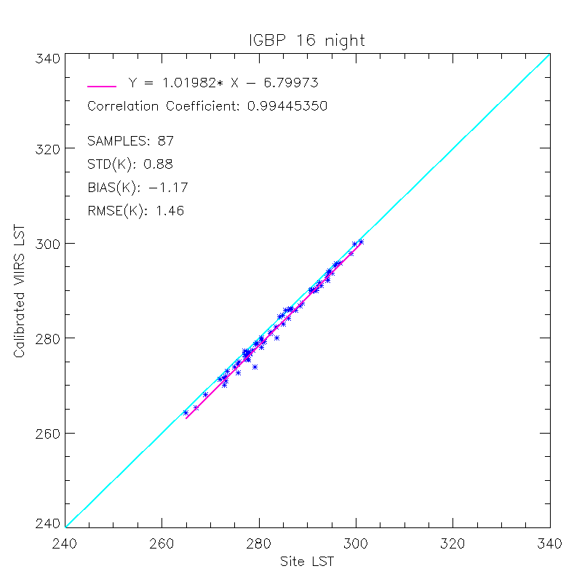
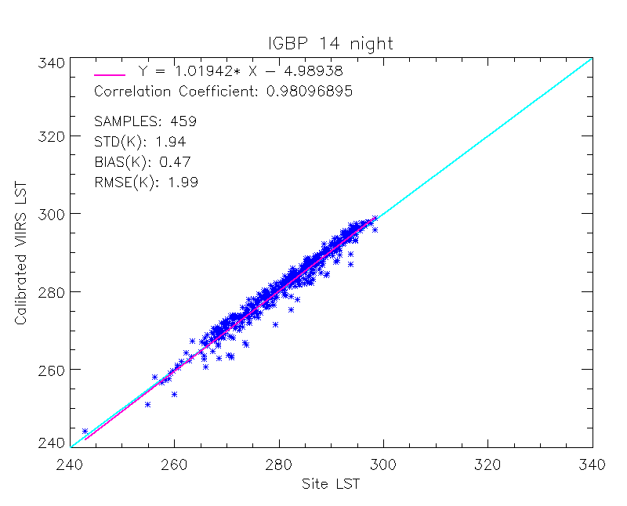
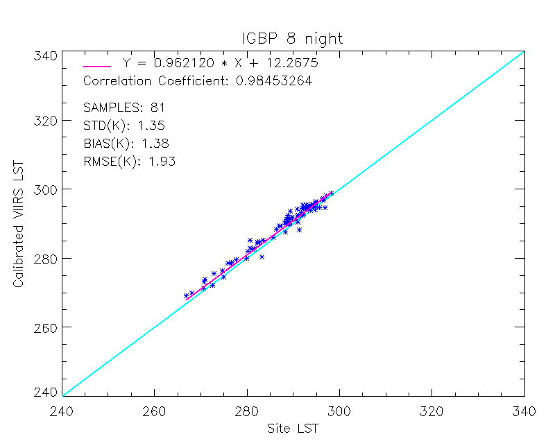
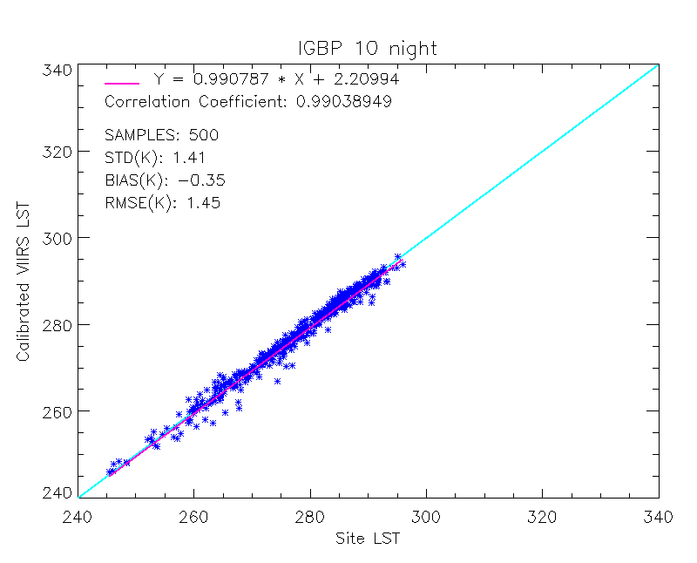
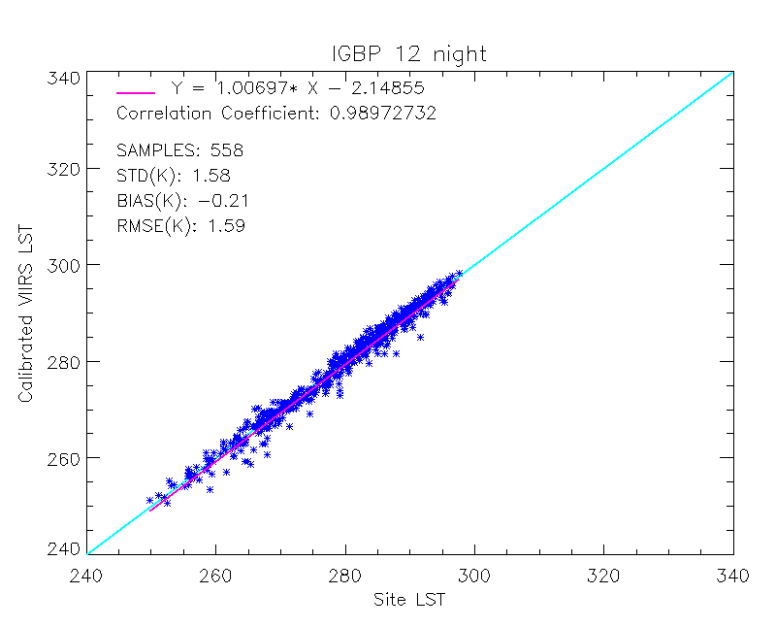
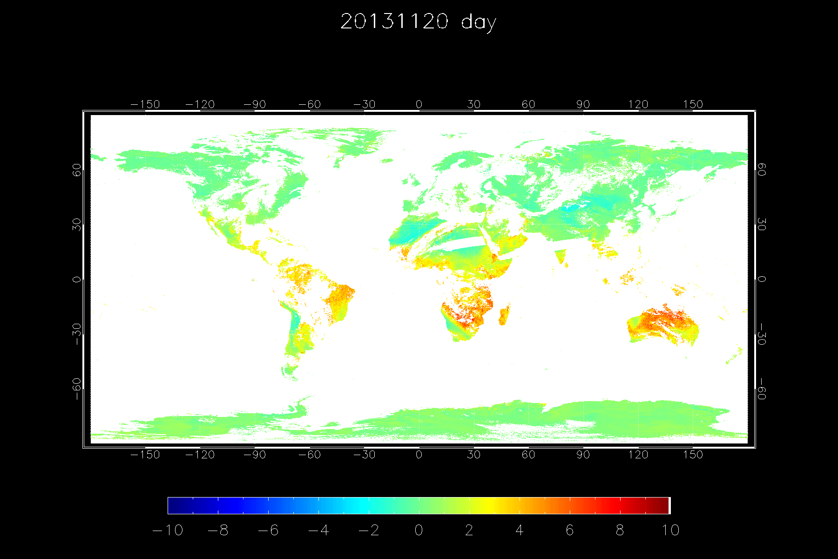
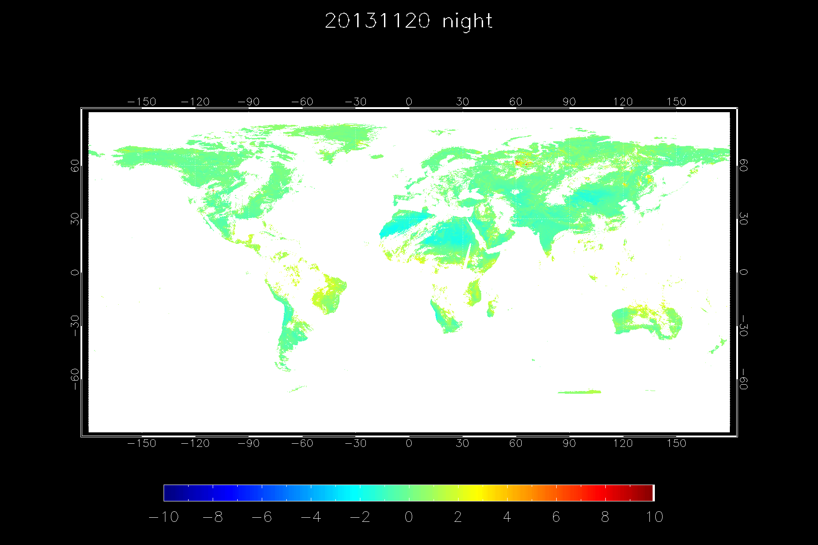
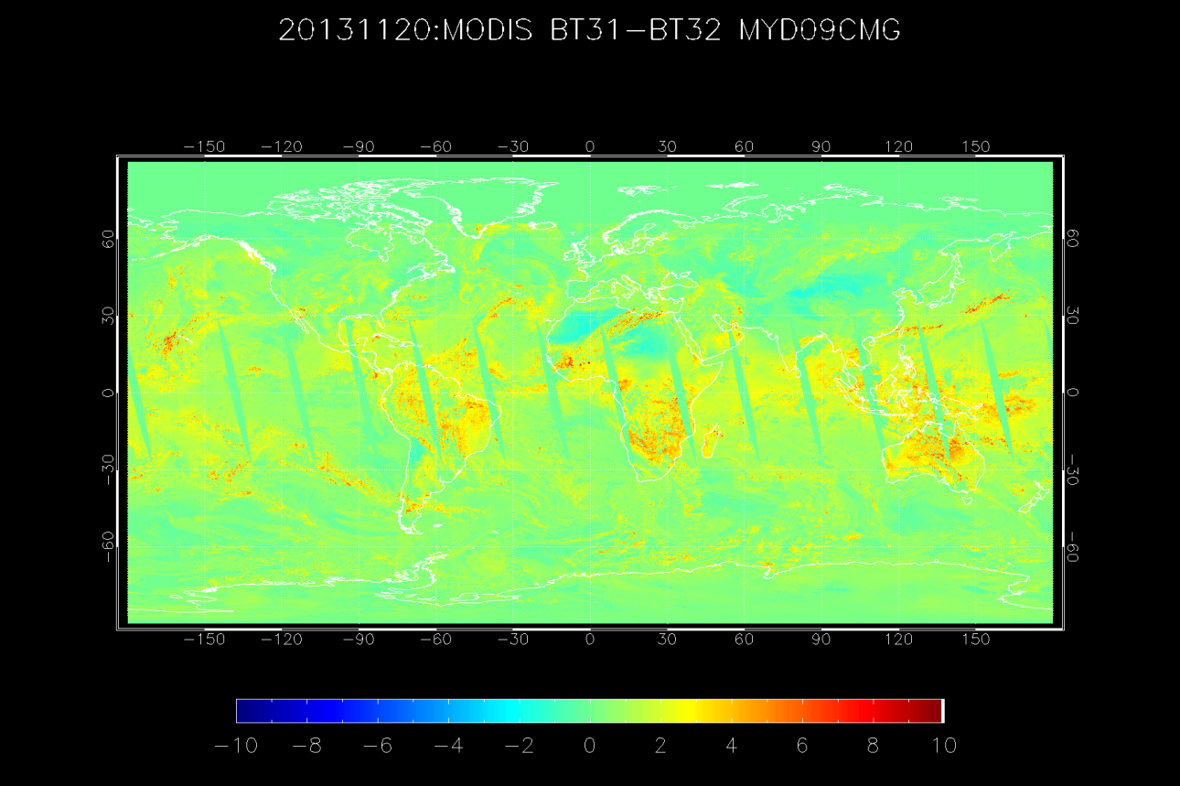
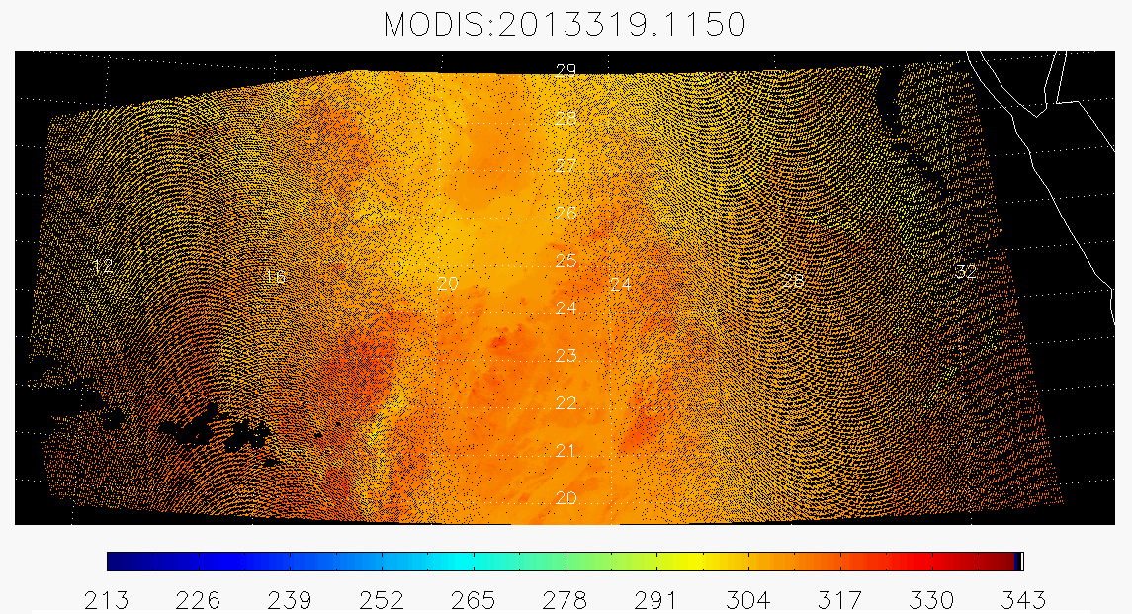
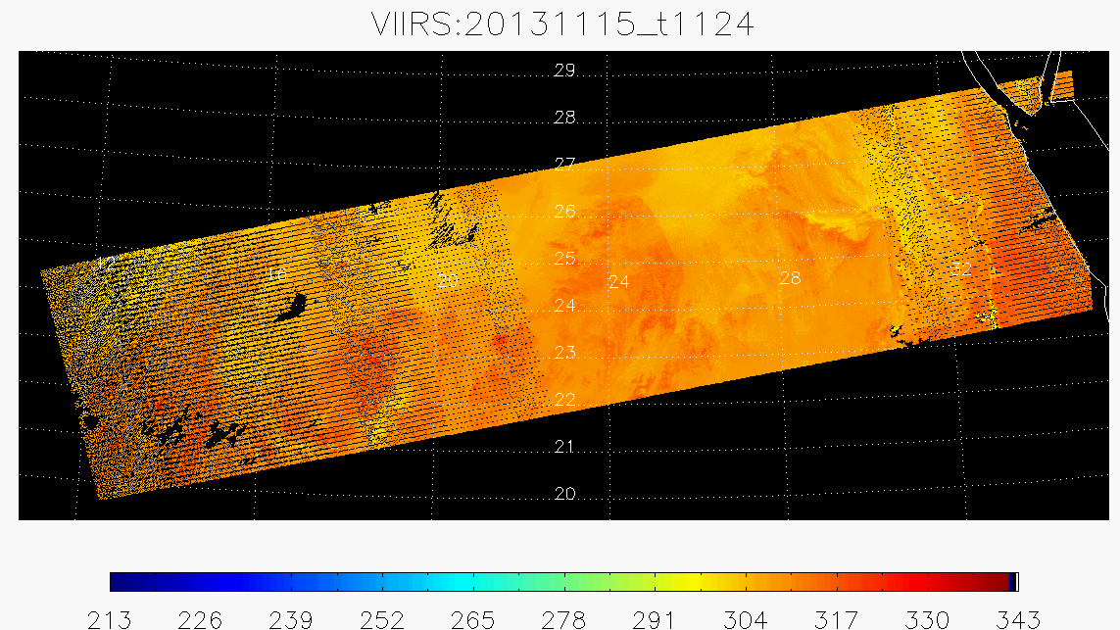
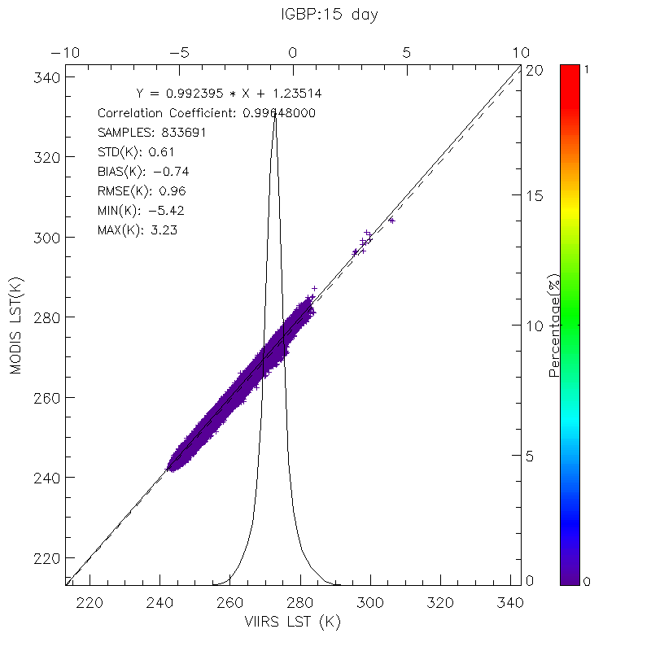
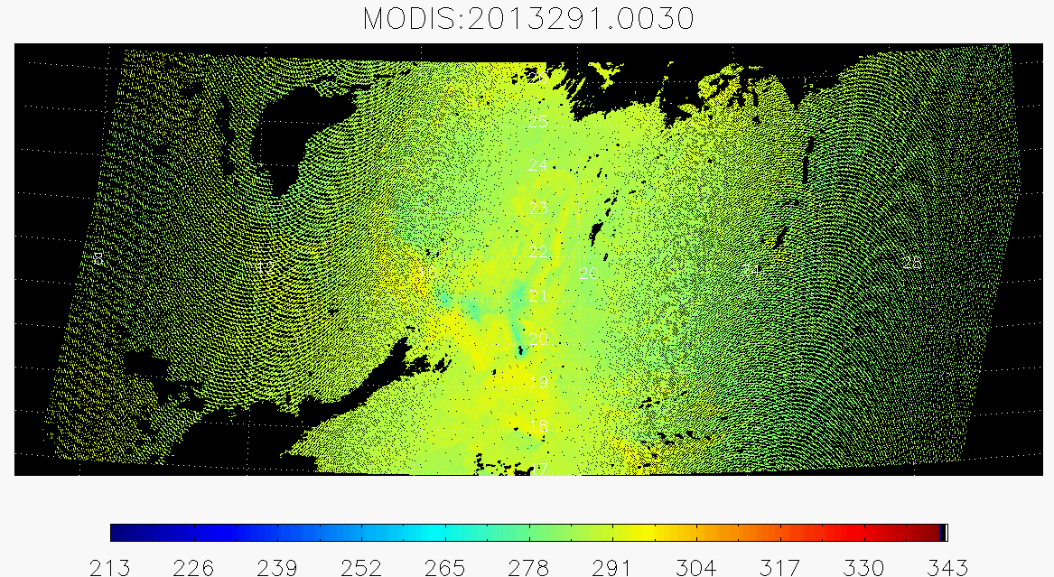
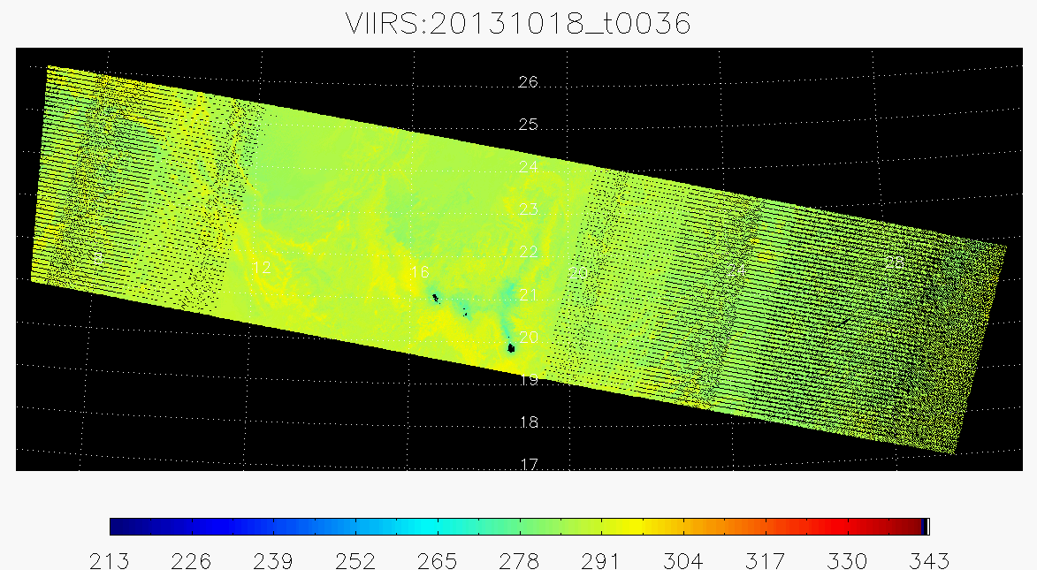
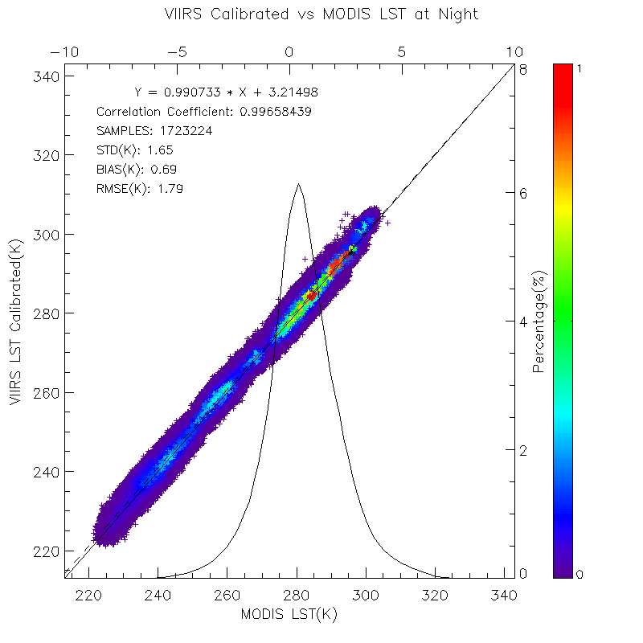
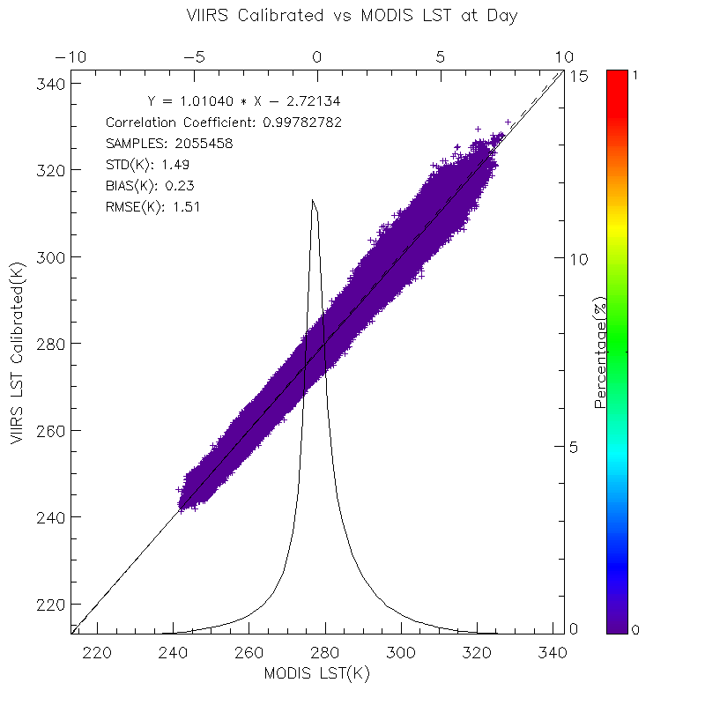
Evaluation of the Suomi NPP VIIRS Land Surface Temperature Product
Yuling Liu¹, Yunyue Yu² , Cezar Kongoli^{1,2}, Zhuo Wang¹, Peng Yu¹
¹CICS, University of Maryland, College Park; ² STAR/NESDIS/NOAA
Introduction
The Visible Infrared Imaging Radiometer Suite (VIIRS), aboard the Suomi National Polar-orbiting Partnership (S-NPP) satellite, is the sensor to provide measurements of the atmospheric, land and oceanic parameters which are referred to as Environmental Data Records (EDRs). Land Surface Temperature (LST), one of the EDR products, provides the measurement of the skin temperature over global land coverage including coastal and inland water. The LST EDR is derived from a baseline split-window regression algorithm. Coefficients of the LST algorithm are surface type dependent, referring 17 International Geosphere-Biosphere Programme (IGBP) types, with a separation for day and night.
This study presents an evaluation of the LST product and addresses some issues in the algorithm development. The evaluation is mainly carried out using the conventional temperature-based approach by comparisons between the VIIRS LSTs and in-situ LSTs, and cross satellite comparison with MODIS LST. The ground evaluation result shows that VIIRS LST agrees well with the measurements from SURFRAD, with a better performance at nighttime than at daytime. However, the performance varies over surface types.
The cross satellite evaluation is mainly conducted with MODIS considering that VIIRS LST will replace MODIS LST in the future, and the comparisons are mostly over Simultaneous Nadir Overpasses (SNO) between VIIRS and Aqua. Comparison results show an overall close agreement between VIIRS and MODIS LST, but the difference in LST displays a regional stripe feature. In detail, a relatively large LST difference is found in low latitude areas such as South America and northern Australia, attributed to the significant brightness temperature difference between the two split window channels which the current VIIRS algorithm cannot handle well.
VIIRS LST EDR Calibration
Ground Evaluation
Baseline Split window algorithm
Establish the 2-band 10.76µm(M15) and 12.01µm(M16) split window algorithm for both day and night based on regression equation for each of the 17 IGBP surface types.
Ground data from SURFRAD
Beta
Radiance based Simulation
Improvement for LST EDR is based on update of algorithm coefficients.
Two steps of calibration:
  calibration from the radiance based simulation
  calibration from comparisons to the reference dataset, i.e. ground truth and MODIS Aqua LST product.
Calibration is based on the annual performance rather than the seasonal performance.
Provisional
LUT Generation
The ground data from The Surface Radiation Budget Network (SURFRAD) are used for the evaluation. The data covers the time period from Feb. 2012 to December 2013.
Regression Calibration
Ground calibration
MODIS calibration
Flow chart of LST calibration
Global LST Image
LST performance over surface types and
day/night conditions
Cross Satellite Evaluation
Issues
MYD11_L2, MODIS/Aqua Land Surface Temperature 5-Minute L2 Swath at 1 km is used as a reference for the cross satellite evaluation.
Large brightness temperature difference between the two split window channels
North east Africa on Nov.15, 2013 : daytime (top) and nighttime(bottom):
Suspicious misclassification of some surface types
    Emissivity range obtained from MOD11A2-Land Surface Temperature & Emissivity 8-Day L3 Global 1km with the land cover from UMD at 1km resolution
month | surface type | Emi31_min | Emi31_max | Emi31_mean | Emi32_min | Emi32_max | Emi32_mean
Jan | Water | 0.964 | 0.994 | 0.979 | 0.966 | 0.99 | 0.978
Jan | Evergreen Needleleaf Forest | 0.964 | 0.994 | 0.979 | 0.968 | 0.99 | 0.979
Jan | Evergreen Broadleaf Forest | 0.966 | 0.994 | 0.98 | 0.972 | 0.99 | 0.981
Jan | Deciduous Needleleaf Forest | 0.972 | 0.994 | 0.983 | 0.976 | 0.99 | 0.983
Jan | Deciduous Broadleaf Forest | 0.966 | 0.994 | 0.98 | 0.972 | 0.99 | 0.981
Jan | Mixed Forest | 0.964 | 0.994 | 0.979 | 0.972 | 0.99 | 0.981
Jan | Woodland | 0.964 | 0.994 | 0.979 | 0.97 | 0.99 | 0.98
Jan | Wooded Grassland | 0.964 | 0.994 | 0.979 | 0.97 | 0.99 | 0.98
Jan | Closed Shrubland | 0.964 | 0.994 | 0.979 | 0.972 | 0.99 | 0.981
Jan | Open Shrubland | 0.964 | 0.994 | 0.979 | 0.97 | 0.99 | 0.98
Jan | Grassland | 0.964 | 0.994 | 0.979 | 0.97 | 0.99 | 0.98
Jan | Cropland | 0.964 | 0.994 | 0.979 | 0.97 | 0.99 | 0.98
Jan | Bare Ground | 0.964 | 0.994 | 0.979 | 0.968 | 0.99 | 0.979
Summary and Future Work
VIIRS LST shows a good overall agreement with ground LST measurements, with a better performance achieved at nighttime than at daytime. However, the performance varies with surface type. LST is underestimated over closed shrub lands at both daytime and nighttime, open shrub lands and barren surface at nighttime, woody savannas and snow/ice surface at daytime. The evaluation results over barren surface at daytime conflict with the results obtained using measurements in Africa, the latter showing an obvious underestimation of VIIRS LST both at daytime and nighttime. Possible explanations for this apparent inconsistency include homogeneity of the site, ground in-situ quality control, emissivity used to calculate the ground LST and regional atmospheric condition that might affect LST retrieval.
VIIRS LST is in close overall agreement with MODIS LST. Disagreements are shown over areas with large brightness temperature difference between the two retrieval channels, and these disagreements are reduced after calibration.
Several issues need to be well addressed in the algorithm development. Since VIRIS LST algorithm is a surface type dependent algorithm, it underperforms over surface types that vary seasonally (which is not reflected in the surface type EDR), and misclassified surface types. The appropriate emissivity setting for all IGBP surface types is very important for the simulation. The large variation of emissivity over surface types makes it difficult to determine the representative emissivity setting for each IGBP surface type and the uncertainty from the emissivity and land cover type product also introduce error into the procedure.
Comparison results from Simultaneous Nadir Overpass (SNO) between VIIRS and AQUA in 2012 and Oct-Dec, 2013. The matchups are quality controlled with additional cloud filter for both LST measurements.

