Slide 1
Inter-Comparison of Suomi NPP CrIS with AIRS and IASI toward Infrared Hyperspectral Benchmark Radiance Measurements
Likun Wang^{1*}, Yong Han², Yong Chen¹, Denis Tremblay³, Xin Jin⁴
1. CICS/ESSIC/University of Maryland, College Park, MD
2. NOAA/NESDIS/STAR, College Park, MD
3. Science Data Processing, Inc, Laurel, MD
4. Earth Resources Technology, Inc., Laurel, MD
*Email: wlikun@umd.edu
2014 EUMETSAT Conference, September 24 2014; Geneva, Swiss

Slide 2
Outline
CrIS operation concept and cal/val activities
Inter-comparison methodology
Results
CrIS vs. IASI-A and IASI-B
CrIS vs. AIRS
Conclusion

Slide 3
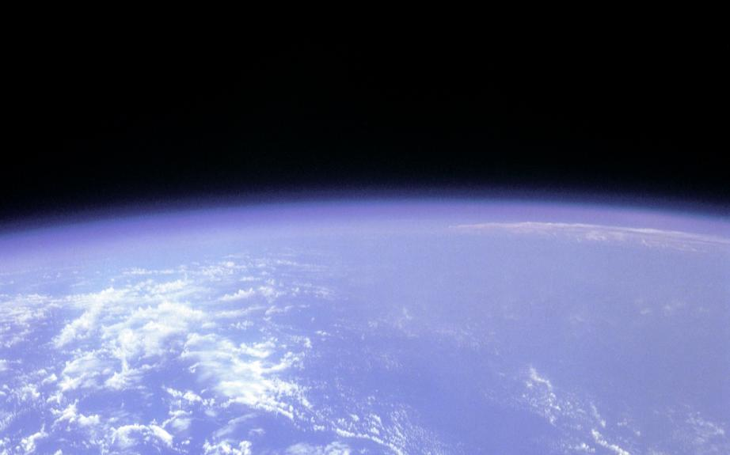
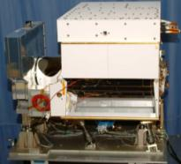
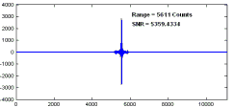
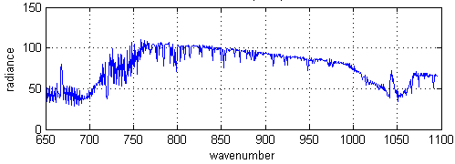
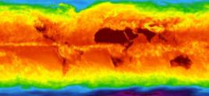
CrIS Operational Concept
CrIS on NPP
RDR = Raw Data Record
SDR = Sensor Data Record
EDR = Environmental Data Record
±50° Cross track Scans
Downlink
RDRs
RDRs
Decode Spacecraft Data
30 Earth Scenes
Interferograms
Ground Station
SDRs
2,200 km Swath
CrIS SDR Algorithm
Calibrated / Geolocated Spectra
3x3 Array of CrIS FOVs (Each at
14-km Diameter)
EDRs
Co-Located ATMS SDRs
NWP, EDR Applications
Global Temperature, Moisture, Pressure Profiles

Slide 4
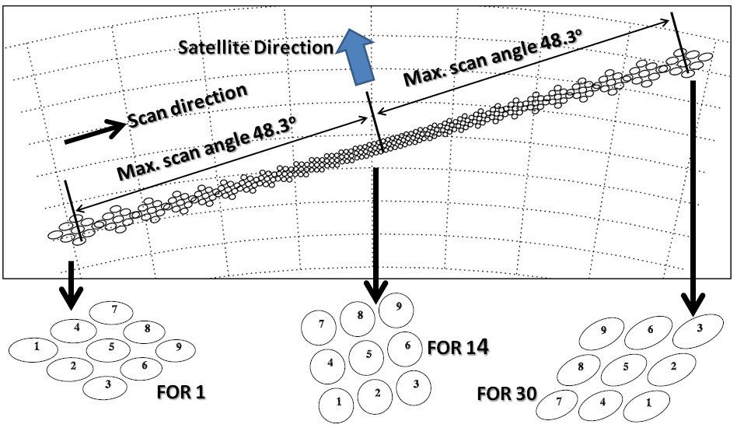
CrIS Scan Pattern
North
(~50km, nadir)
FOV – Field OF View
FOR – Field OF Regard
FOV (14km, nadir)
Swath is 2200 Km (FOR1 to FOR 30).
CrIS acquires 1 scan line every 8 seconds.
CrIS measures 8.7 million spectra per day.

Slide 5
CrIS SDR CalVal Milestones
*Algorithm and software improvement
*CrIS performance characterization
*Radiometric CalVal
*Spectral CalVal
*Geolocation CalVal
*CrIS instrument and SDR trending and monitoring
04/02/2012
First SDR product
04/19/2012
Beta status
01/13/2013
Provisional status
10/15/2014
Full spectral resolution mode
02/20/2014
Validation status;
Calibration algorithm and
coefficient updates (Mx8.1)
Intensive Calibration & Validation (ICV)
2211 channels
1305 channels

Slide 6
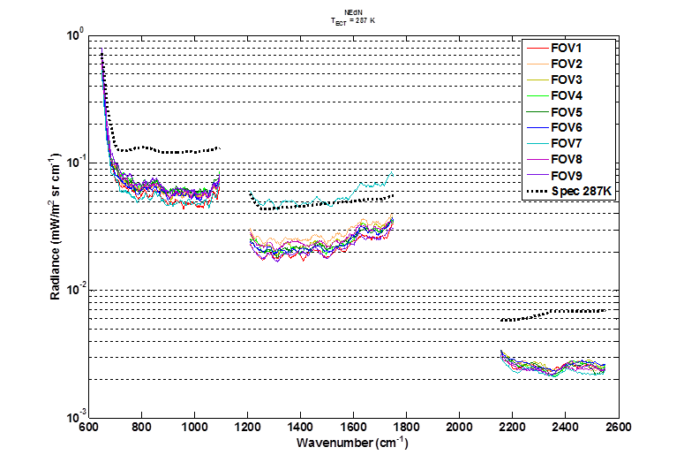
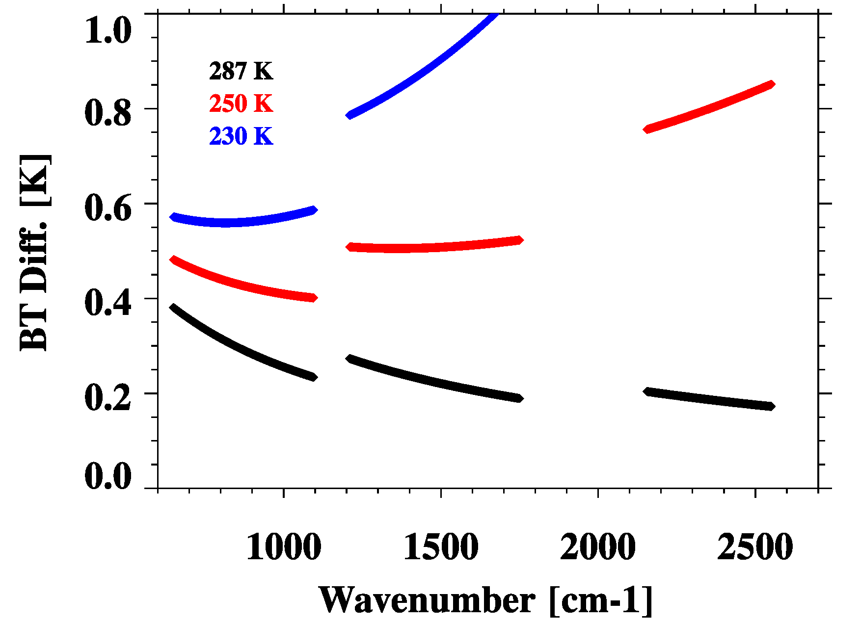
Calibration Uncertainty and Specifications
CrIS SDR uncertainties (red) vs. specifications (black)
Band | Spectral range (cm⁻¹) | N. of chan. | Resolution (cm⁻¹) | FORs per Scan | FOVs per FOR | NEdN @287K BB mW/m²/sr/ cm⁻¹ | Radiometric Uncertainty @287K BB (%) | Spectral (chan center) uncertainty ppm | Geolocation uncertainty km (nadir)
LW | 650-1095 | 713 | 0.625 | 30 | 9 | 0. 14 (0.098) | 0.45 (0.12) | 10 (3) | 1.5 (0.5)
MW | 1210-1750 | 433 | 1.25 | 30 | 9 | 0.06 (0.036) | 0.58 (0.15) | 10 (3) | 1.5 (0.5)
SW | 2155-2550 | 159 | 2.5 | 30 | 9 | 0.007 (0.003) | 0.77 (0.2) | 10 (3) | 1.5 (0.5)
Radiometric uncertainty specification converted to that expressed in brightness temperature
From Vladimir Zavyalov of USU/SDL

Slide 7
Non-linearity Coefficient Changes changed on Feb 20 2014
7
8
9
4
5
6
1
2
3
Longwave
band
Middlewave
band

Slide 8
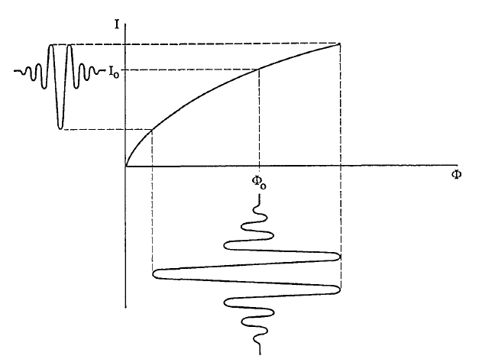
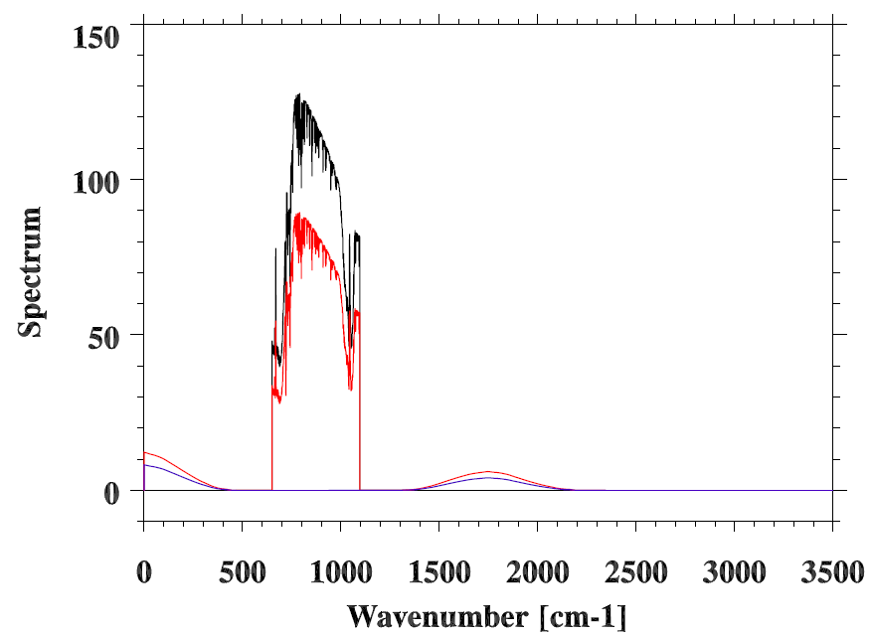
For a non-linear detector
F(Ifg1): linear response
measured dc signal.
F(Ifg2): non-linear response
F(Ifg3): convolution term
Flux
Hypothetical detector-response curve exhibiting nonlinearity. The horizontal axis represents the absolute magnitude of the photon flux and the vertical axis represents the measured dc signal.
Non-linearity responses in spectral domain.
From Abrams et al. 1994

Slide 9
Longwave FOV 5 BT changes: Old a2 – New a2
1042.50 cm-1
900.0 cm-1
1042.50 cm-1

Slide 10
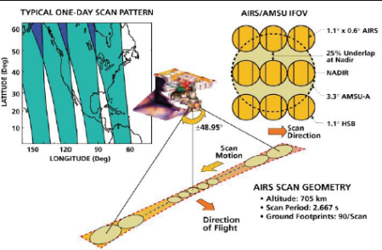
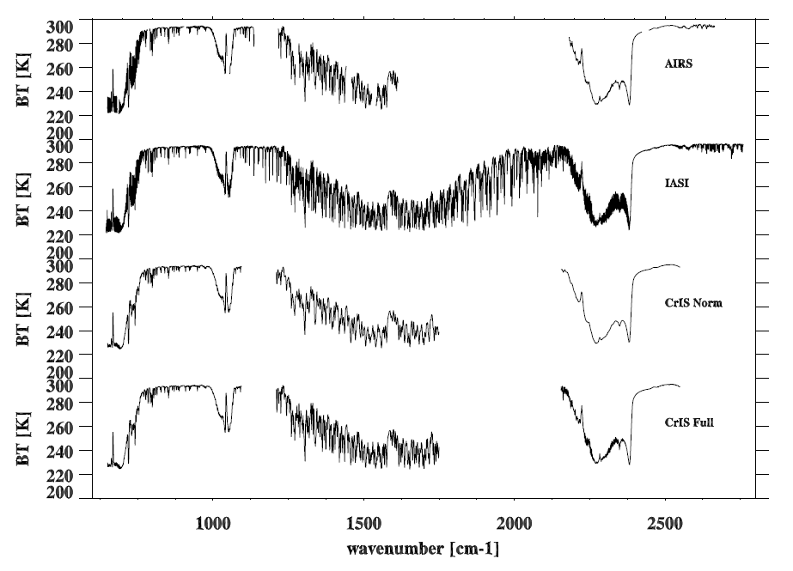
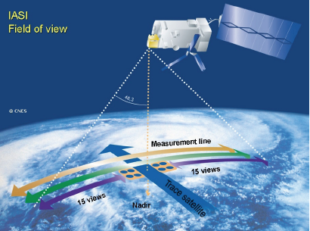
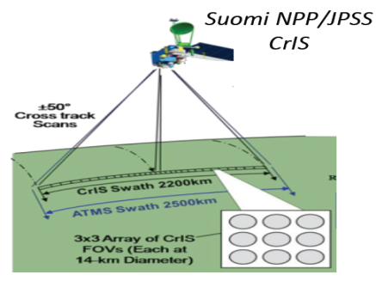
Instrument and Spectral Characteristics
Spectral Coverage and Resolution of
AIRS, IASI, and CrIS
AIRS: 2002-
2378 channels, 9 FOVs/50 km FOR
IASI-A: 2006-
IASI-B: 2012-
8461 channels, 4 FOVs/50 km FOR
CrIS: 2011-
1305 channels, 9 FOVs/50 km FOR
CrIS: 2014.10-
2211 channels, 9 FOVs/50 km FOR

Slide 11
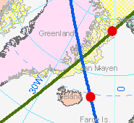
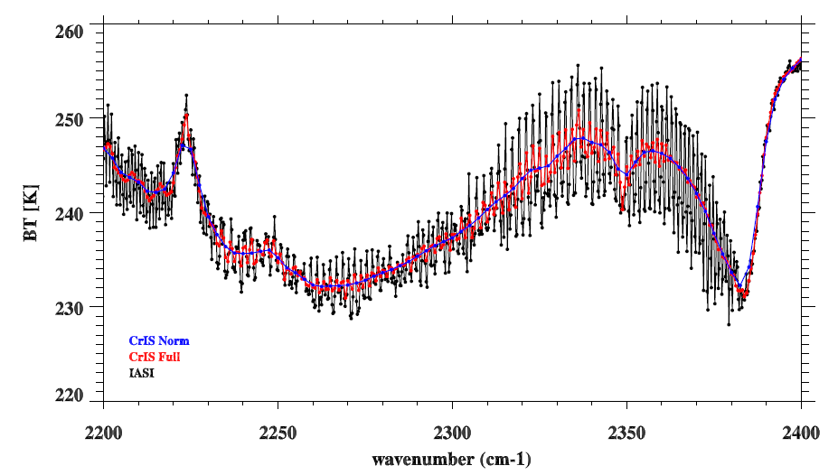
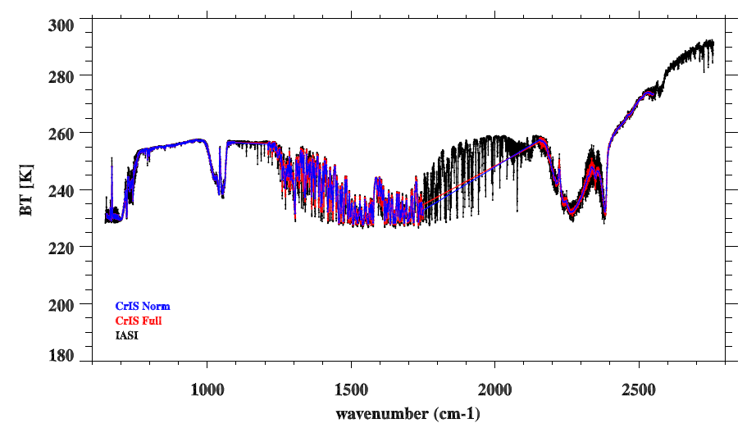
Simultaneous Nadir Overpass (SNO)
CrIS
Time Difference: <= 120 Sec
FOV distance difference: <=(12+14)/4.0 km = 6.5 km
Angle Difference: ABS(cos(a1)/cos(a2)-1) <= 0.01
IASI
From Changyong Cao
SNO Spectra during full resolution test
On August 27 2013

Slide 12
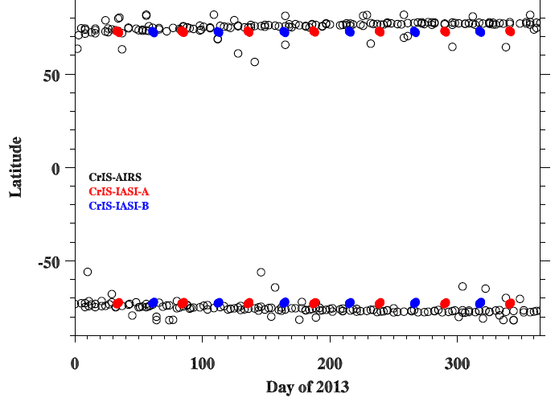
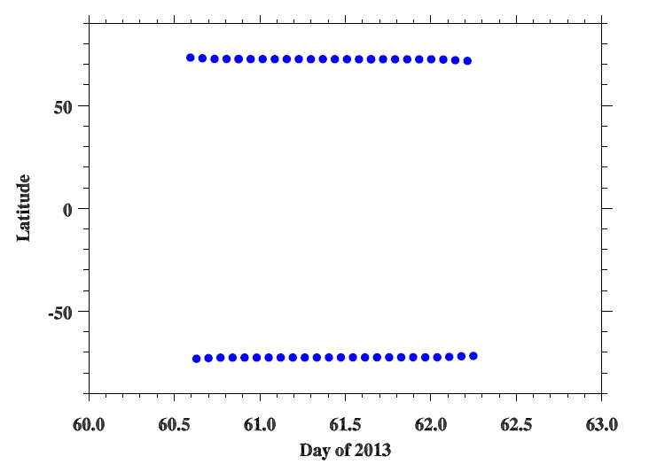
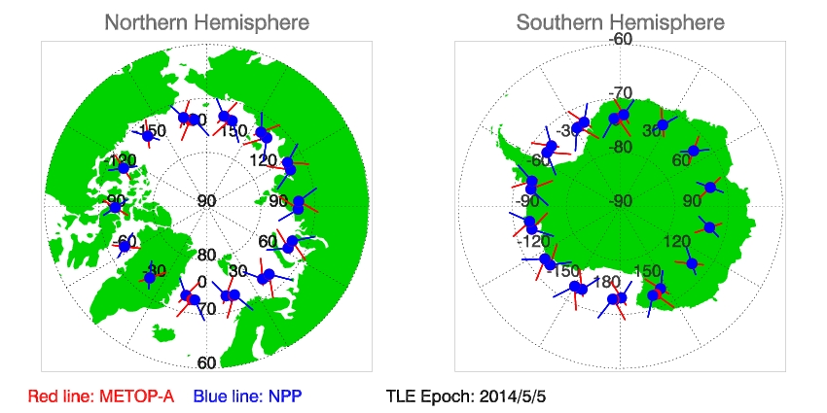
SNOs Latitude Distribution Time Series
The SNOs between SNPP and Aqua occurred every 2-3 days.
the SNOs between MetOp and SNPP occurred every 50 days.
Fortunately, once an SNO event occurs, their orbits will continuously cross each
other every orbit.

Slide 13
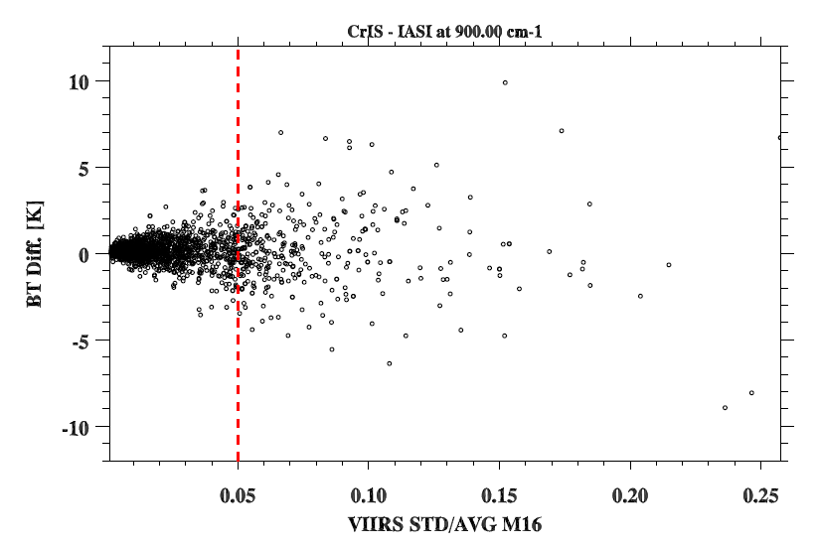
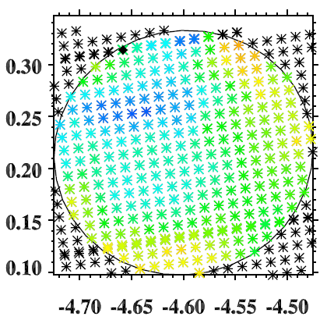
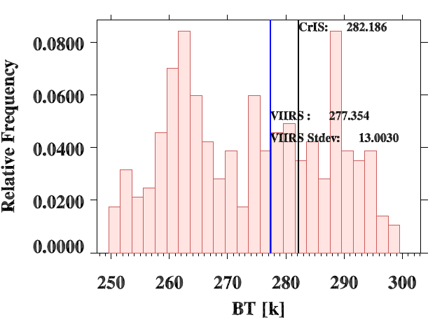
Scene Uniformity Effects
CrIS FOV footprint
Cut off values
Histogram of VIIRS radiances
Radiance nonuniformity within the instrument’s FOV affects ILS associated with each true wavenumber
Inhomogeneous scenes can introduce spatial collocation uncertainties.
The standard deviation to mean ratio of the VIIRS radiances in band 16 is used to select uniform scenes.
Single Line
Self-Apodization
Sinc
Self-Apodization + Sinc

Slide 14
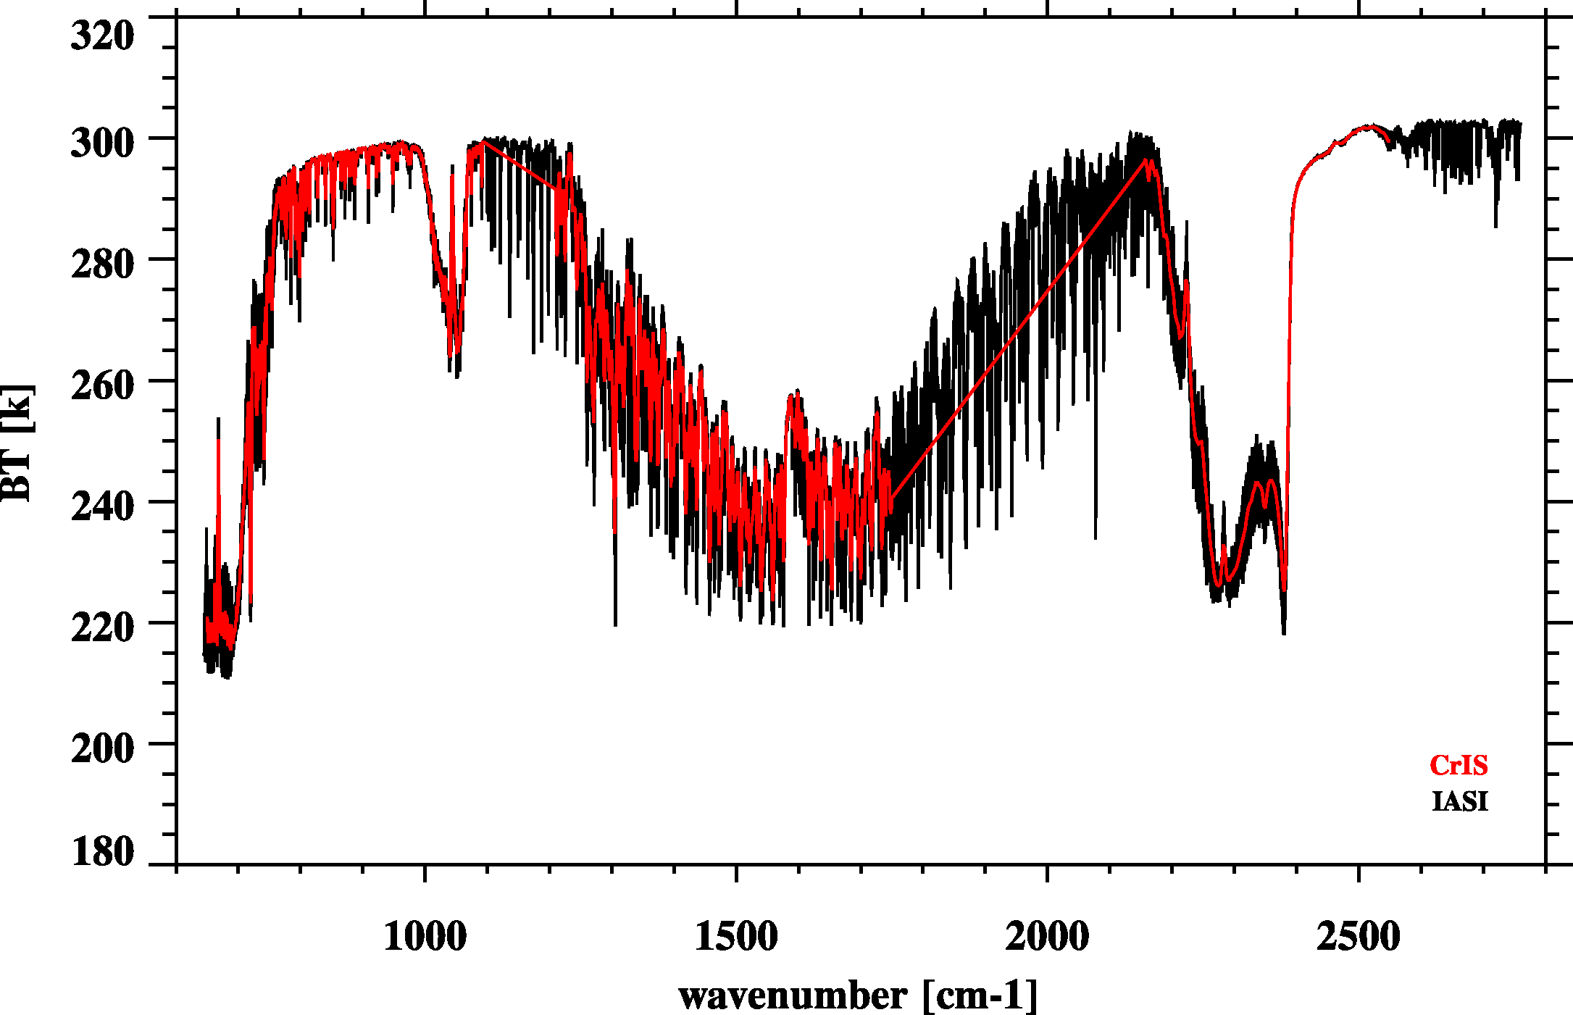
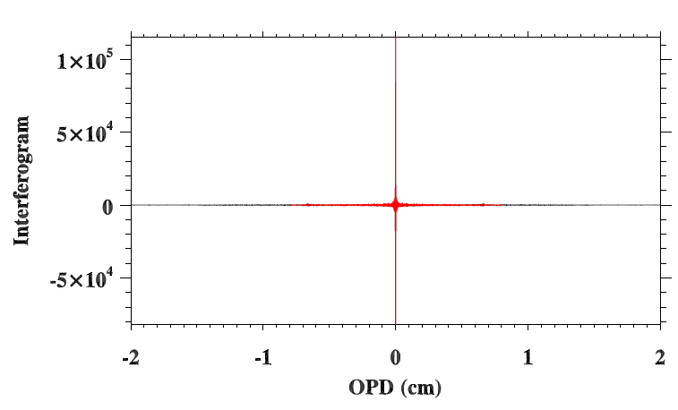
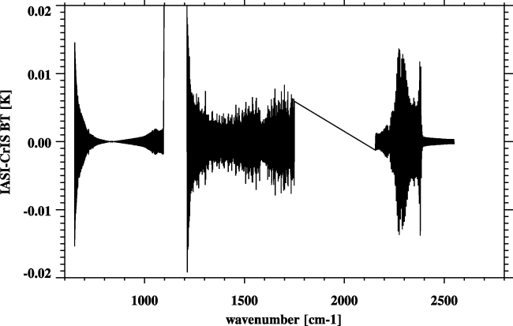
Resample IASI to CrIS
Fourier Transform
CrIS – IASI
1) De-Apodization of IASI spectra
2) Truncation of IASI spectra
3) Apodization using CrIS Hamming Apodization function
Re-sampling error very small
Inverse Fourier Transform

Slide 15
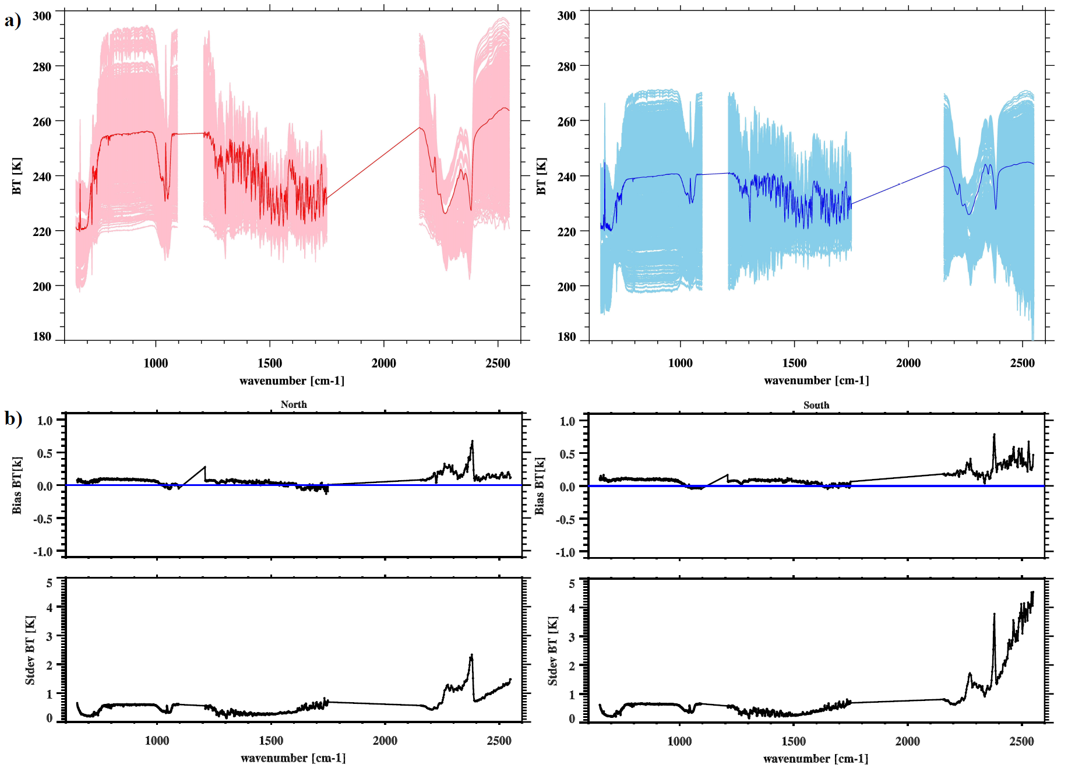
CrIS vs. IASI/MetOp-A
North Pole (1274)
South Pole (1474)
Bias: CrIS-IASI
Bias: CrIS-IASI
STDEV: CrIS-IASI
STDEV: CrIS-IASI

Slide 16
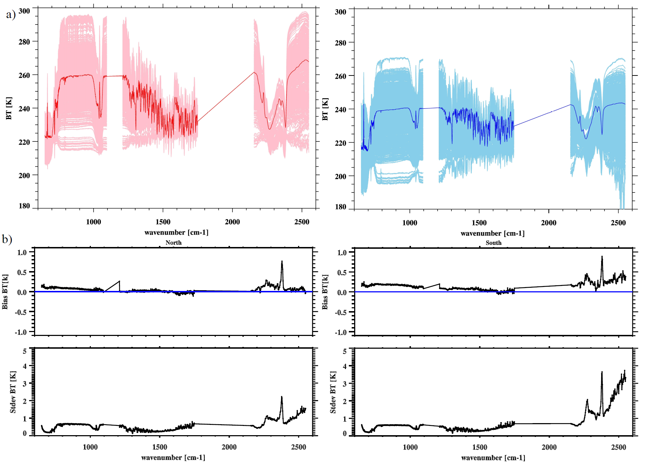
CrIS vs. IASI/MetOp-B
North Pole (952)
South Pole (1056)
Bias: CrIS-IASI
Bias: CrIS-IASI
STDEV: CrIS-IASI
STDEV: CrIS-IASI

Slide 17
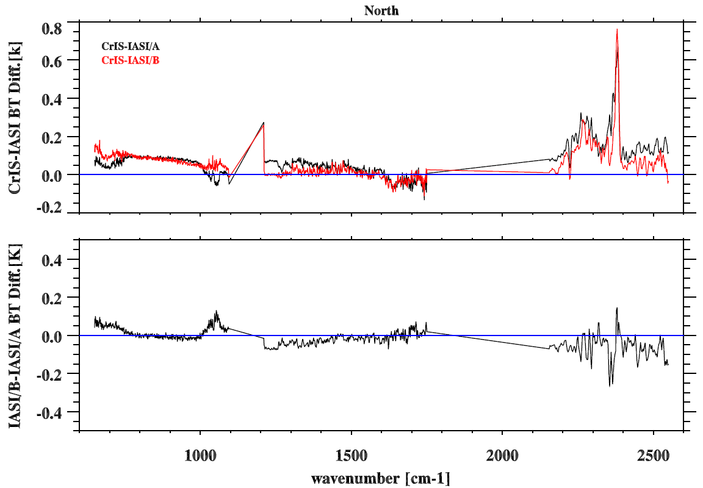
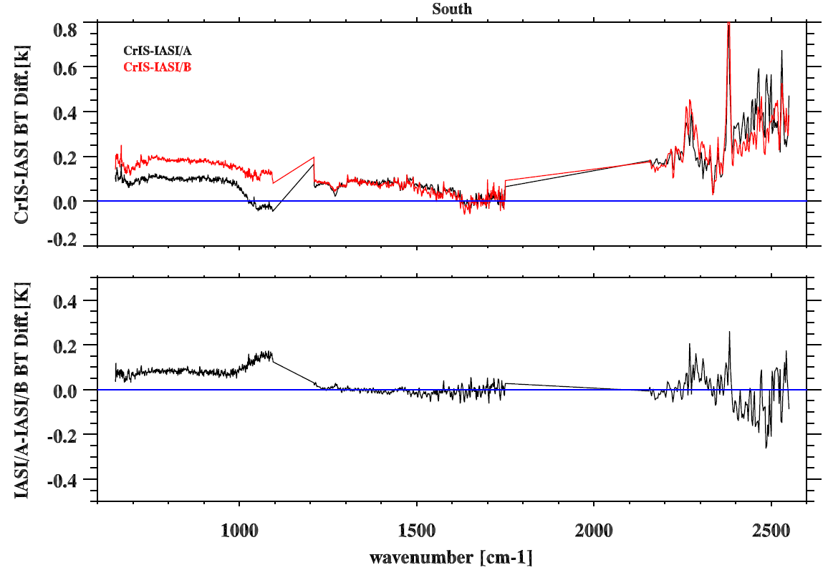
IASI/A minus IASI/B differences (CrIS-IASI/B)-(CrIS-IASI/A)
North Pole
South Pole
IASI/A – IASI-B
IASI/A – IASI-B

Slide 18
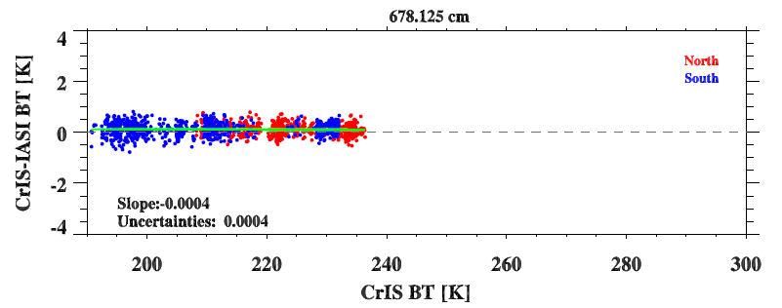
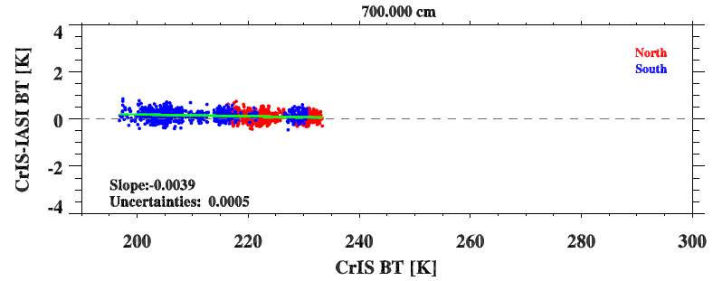
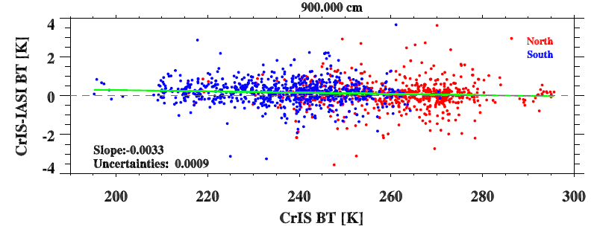
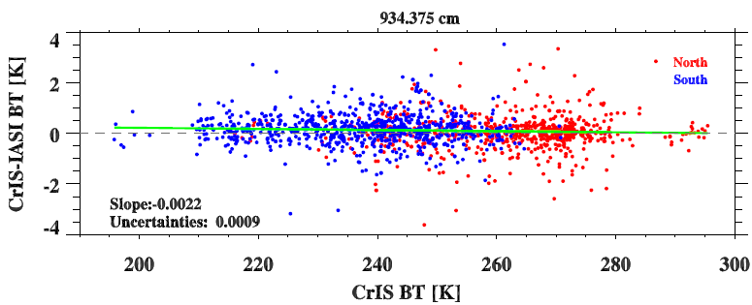
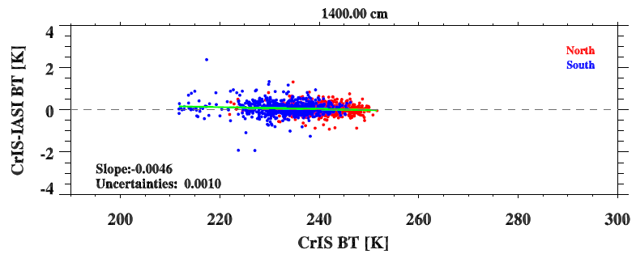
Scene-Dependent Bias

Slide 19
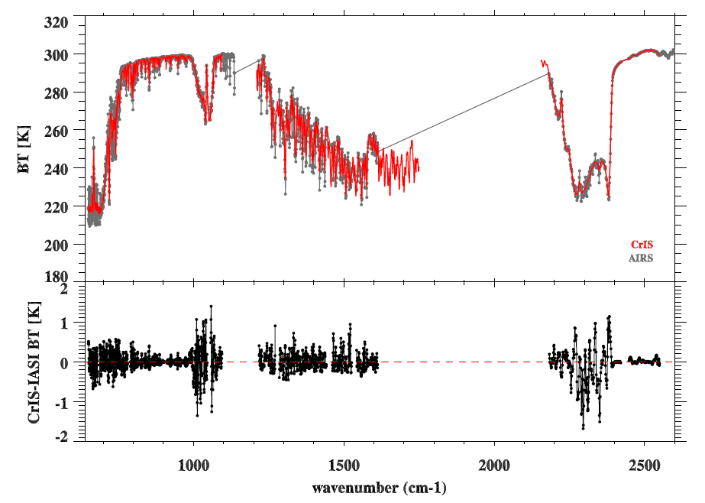
CrIS versus AIRS: The best we can do without reducing the spectral resolution
AIRS Spectrum is convolved with CrIS SRFs (three bands) at each AIRS spectral grid
Resembling CrIS into high-resolution data (e.g. 2^15) and they are convolved with AIRS SRFs
After that, they are at the same spectral grid
The results should be carefully interpreted with cautious.

Slide 20
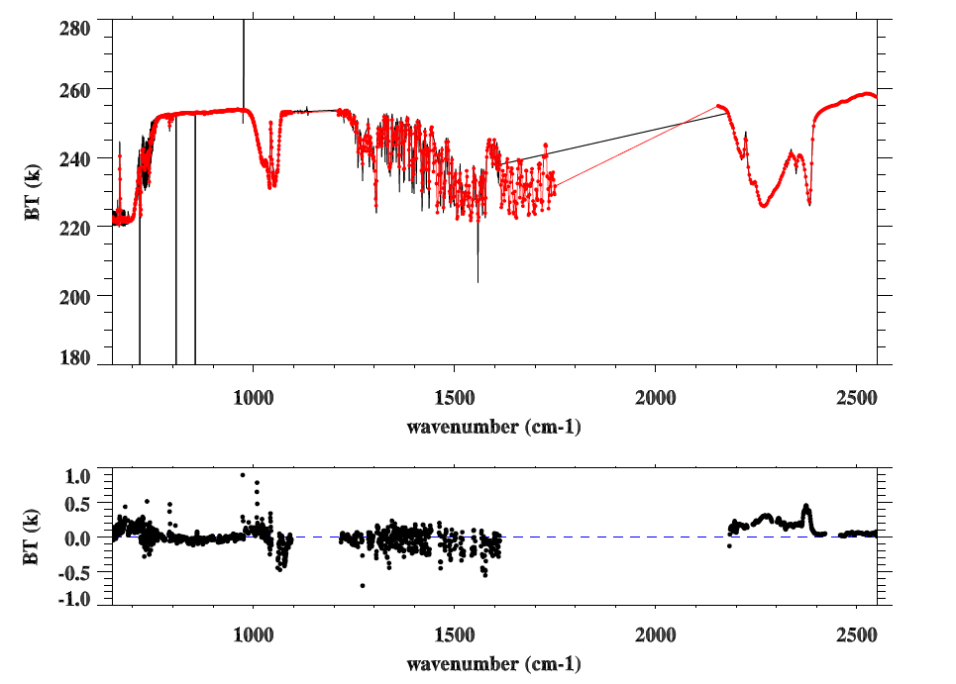
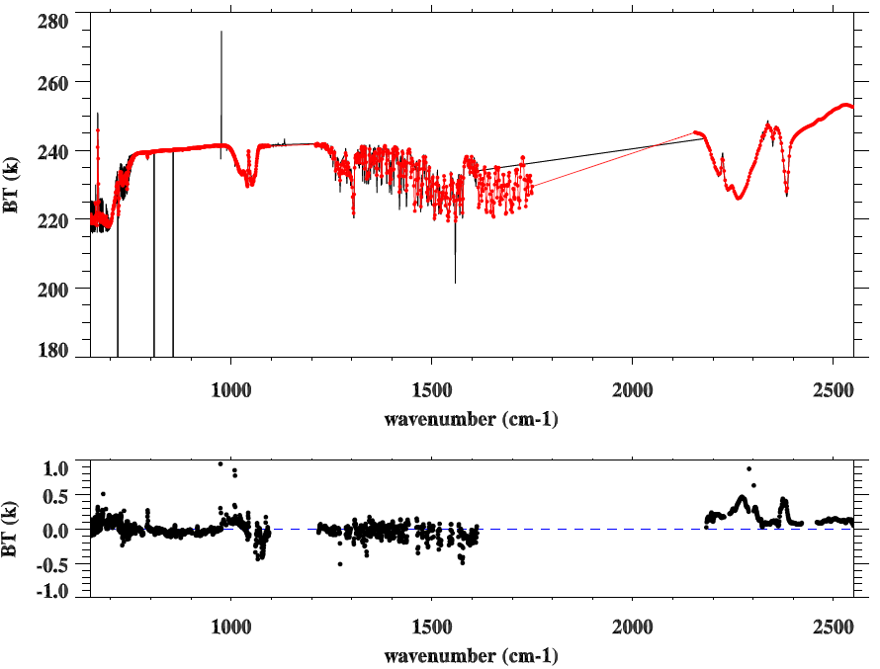
CrIS versus AIRS Daily averaged SNO observations
North: 164/325
South: 161/325
CrIS
AIRS
Large spread could be due to the resampling uncertainties and AIRS bad channels

Slide 21
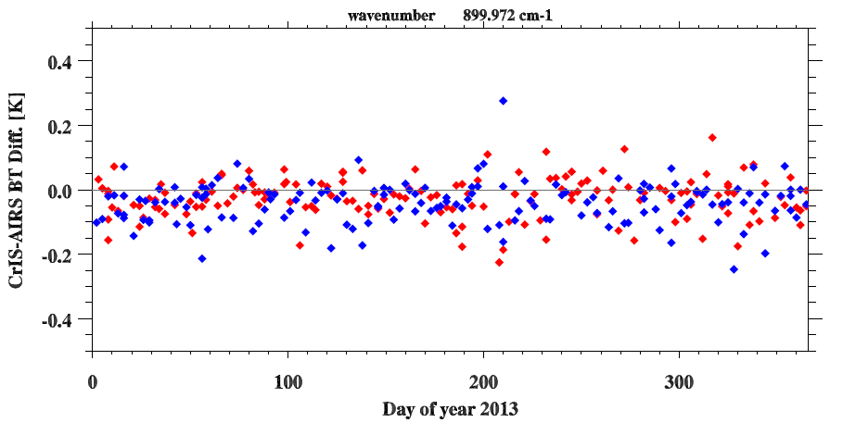
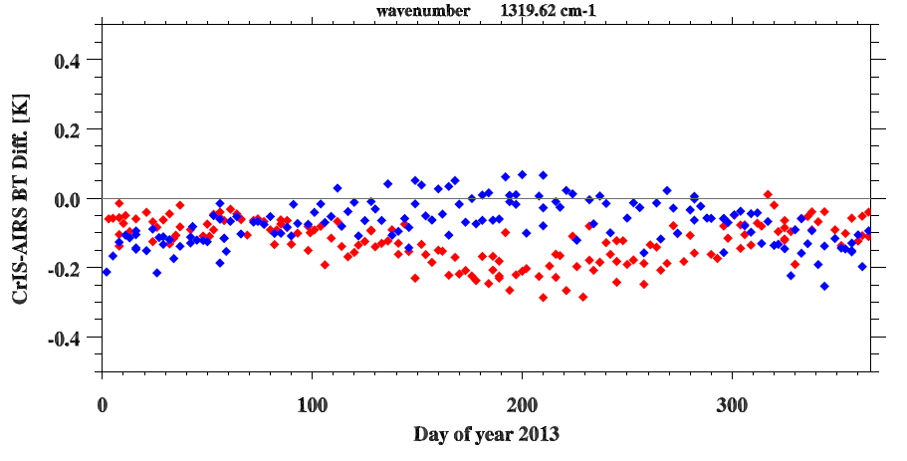
Time Series of CrIS-AIRS
Atmospheric Window
Water Vapor Window

Slide 22
Conclusion
Radiometric and spectral consistency of four IR hyperspectral sounders is fundamental for inter-calibration and climate application.
Inter-comparison of CrIS with IASI/Metop-A, IASI/Metop-B, and AIRS have been made for one year’s of SNO observations in 2013 at polar regions.
CrIS vs. IASI
CrIS and IASI well agree each other at LWIR and MWIR bands with 0.1-0.2K differences
No apparent scene dependent bias
At SWIR band, a sharp increases can be clearly seen at spectral transition region. The reason is still under investigation.
CrIS vs. AIRS
Resampling errors still remain when converting AIRS and CrIS onto common spectral grids. It is challenging to compare CrIS and AIRS without losing spectral resolution.
CrIS and AIRS agree each other at LWIR and MWIR bands from 0.2 to 0.4 K .
At SWIR band, a sharp increases can be clearly seen at spectral transition region.
A weak seasonal variation can been seen for CrIS-AIRS at water vapor absorption region.
The above results will be carefully inspected again using the SNOs at low latitudes.
The comparison will be continued until end of sensor mission, which will provide fundamental information about consistency of hyperspectral sounders to the community.

Slide 24
Comparison between ADL and IDPS
The differences between ADL and IDPS are negligible.
From Xin Jin/STAR

Slide 25
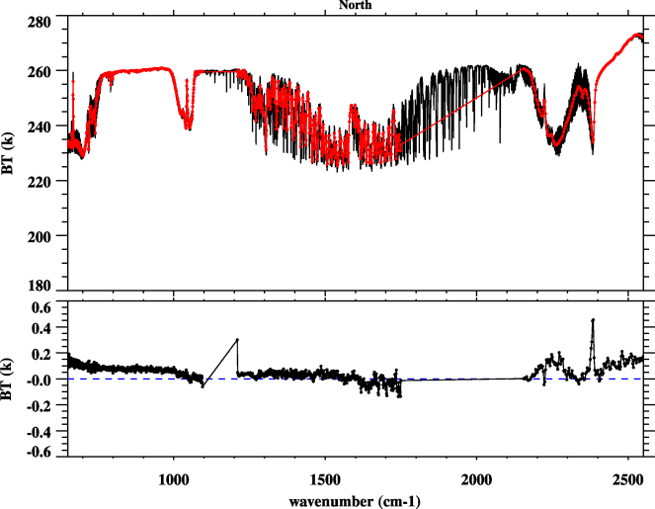
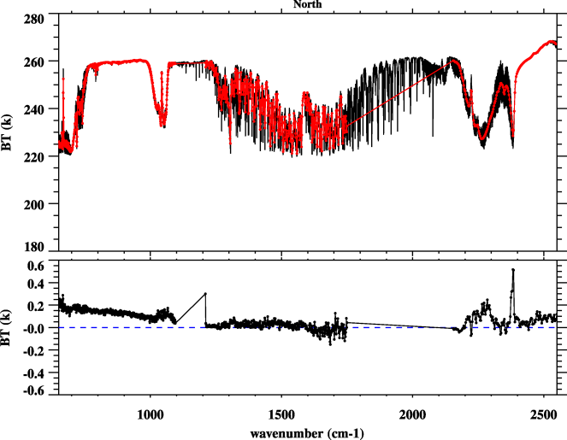
CrIS-IASI with New a2 values
Metop-A
Metop-B
CrIS IASI
CrIS IASI
Old a2
CrIS-IASI
Old a2
CrIS-IASI
New a2
New a2
The differences between CrIS-IASI is reduced at LW bands with new a2 values.

Slide 26
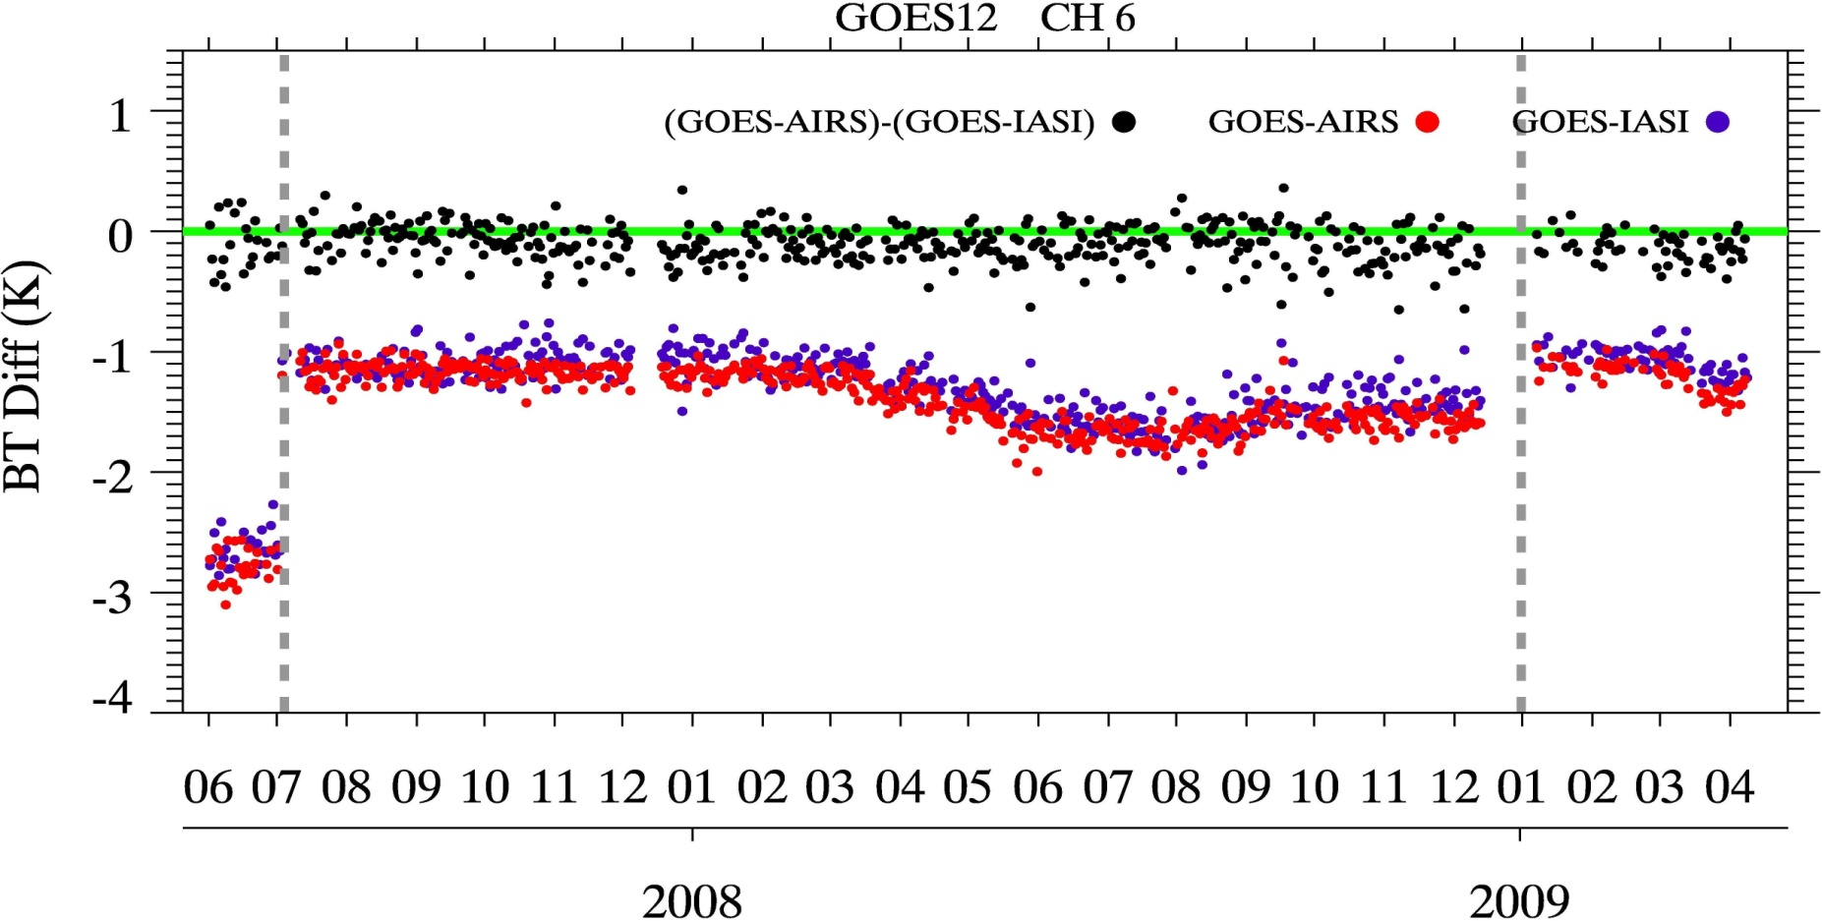
Radiances Consistency of CrIS, IASI, and AIRS
GSICS Framework: Independent Calibration Assessment
Each Agency routinely uses AIRS/IASI to assess calibration accuracy of its own geostationary instruments
GEOS Decontamination
Spectral and radiometric consistency among CrIS, AIRS and IASI is significant for GSICS community.

Slide 27
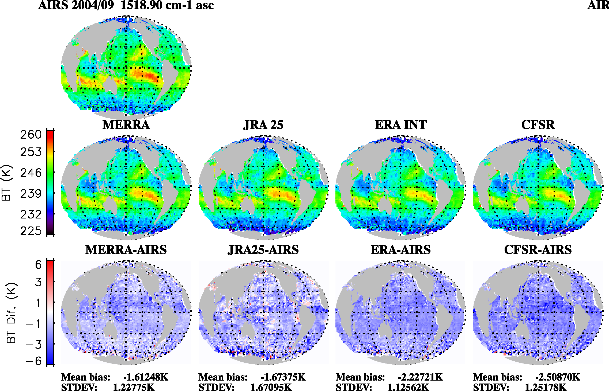
Model Verification
AIRS – Simulations (Reanalysis)
Hyperspectral radiance measurements can serve as a benchmark for model assessment, but the consistency is the key.

Slide 28
Updates on CrIS SDR Calibration Parameters and Software
Provisional status since Jan 31, 2013
Validated since Feb 20, 2014
Mx6.3/6.4
2012-10-15
Geo bug fixed
Imgy rad. DQF implemented
Mx7.1/7.2
2013-07-10
MW Imgy limit lifted to 0.88
Bit-trim table stored in CMO file
Stage2cooler drift limit lifted
EngPktV35
One-scan shift of reference window
Lunar intrusion flag bug
Mx8.1/8.2 with EP36
On 2014-02-20
Time stamp overflow bug fixed
Re-sampling laser wavelength for initial CMO saved in CMO file
Mx8.0
2013-11-14
FIR coefficients are updated
Handling Missing pixel/scan
Handling invalid Geolocation
Re-tasking procedure changed
Handling short granule
FOV5 ILS equation error
Non-linearity equation format change
RDR impulse noise count data type
Full-res truncation module inserted
Time stamp fix for monthly shift
The data used in this study were reprocessed using ADL4.0 (comparable to Mx8.1/8.2) with EP36.
From Xin Jin/STAR

