Slide 1

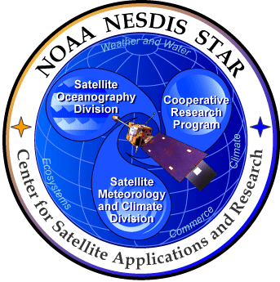
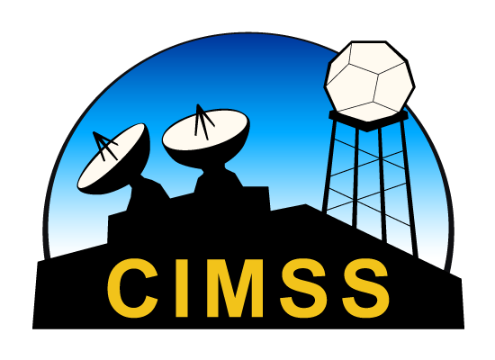


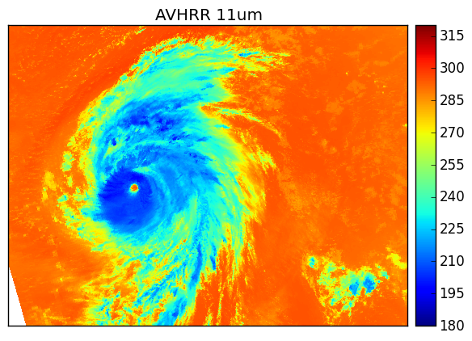
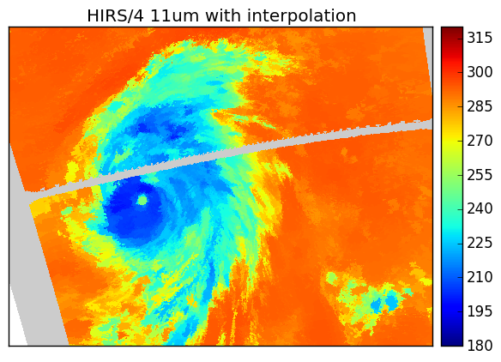
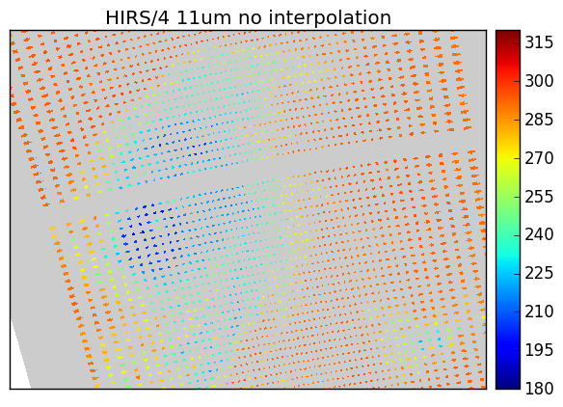
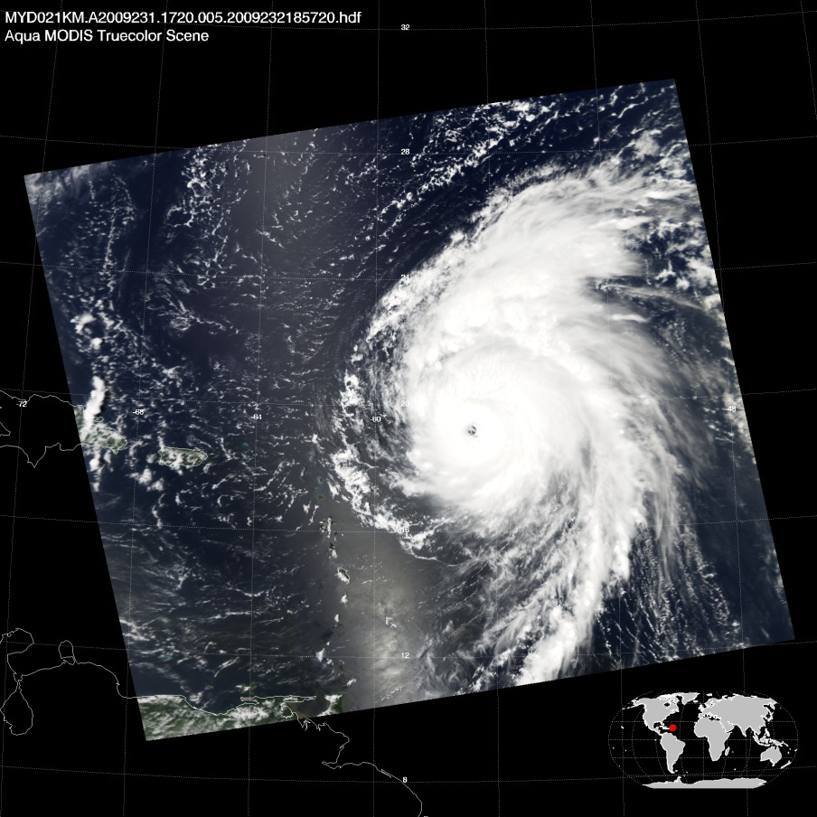
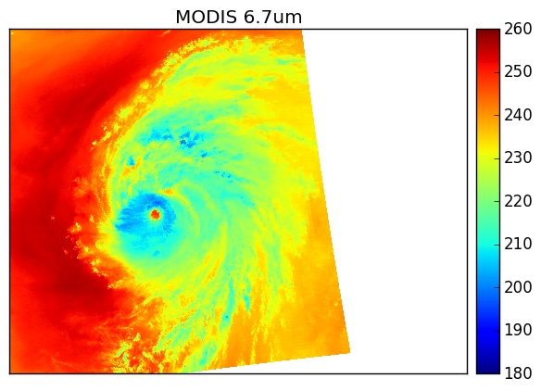
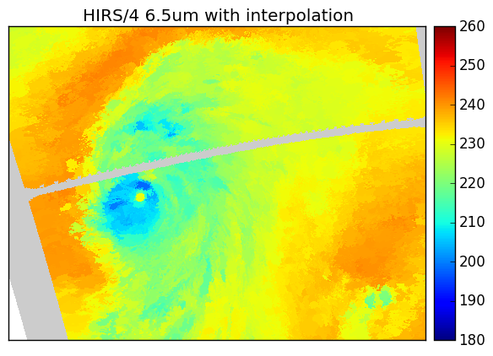
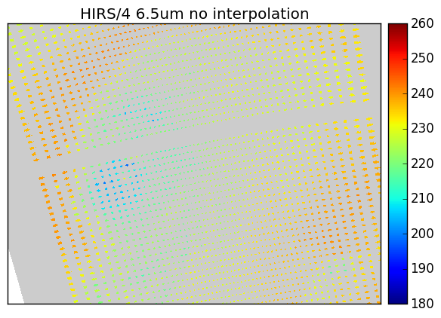
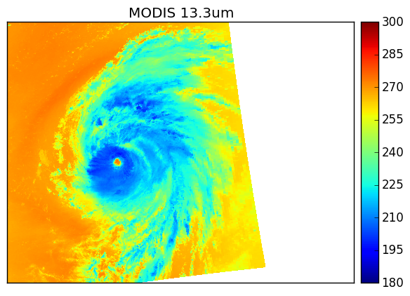
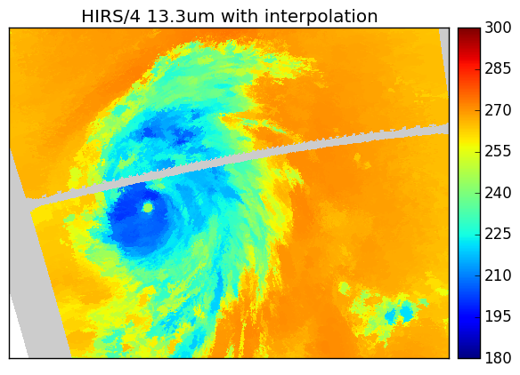
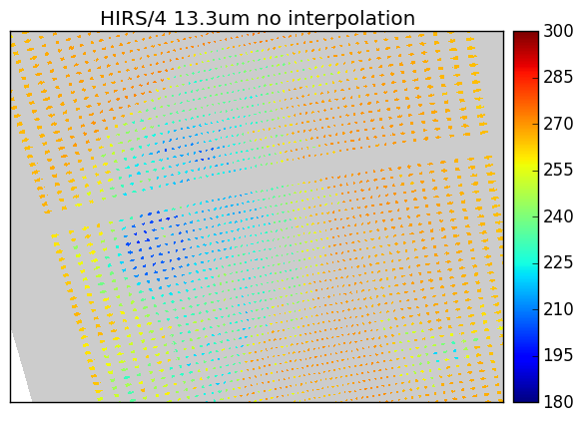
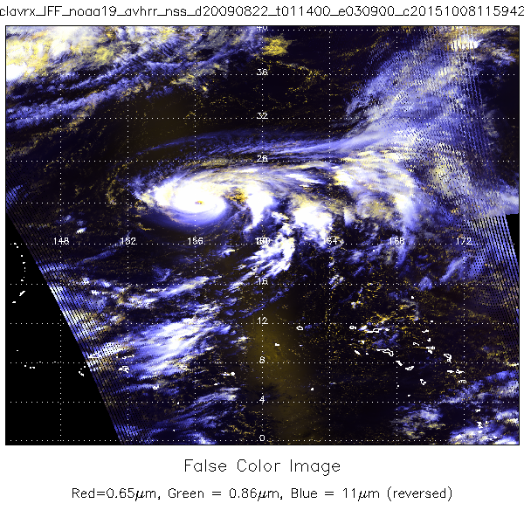
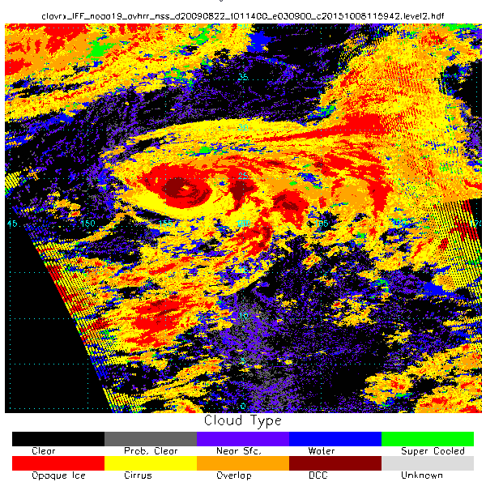
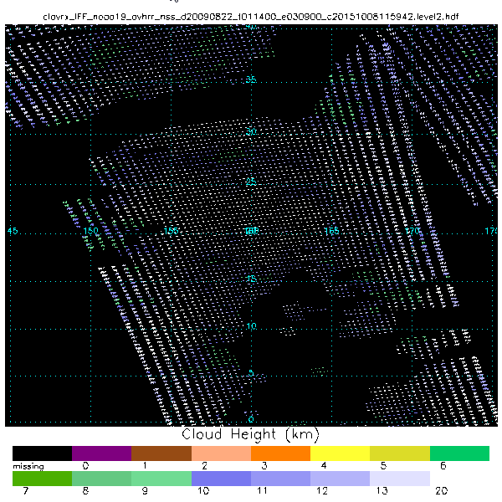
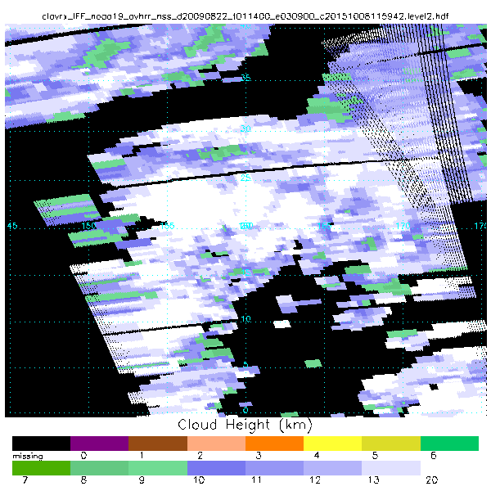
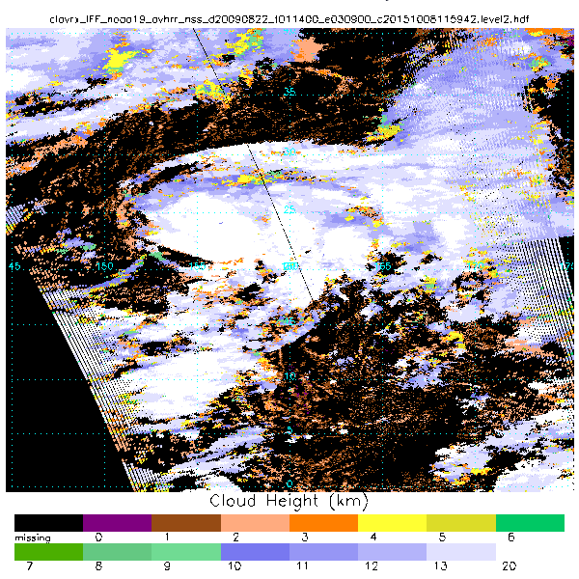
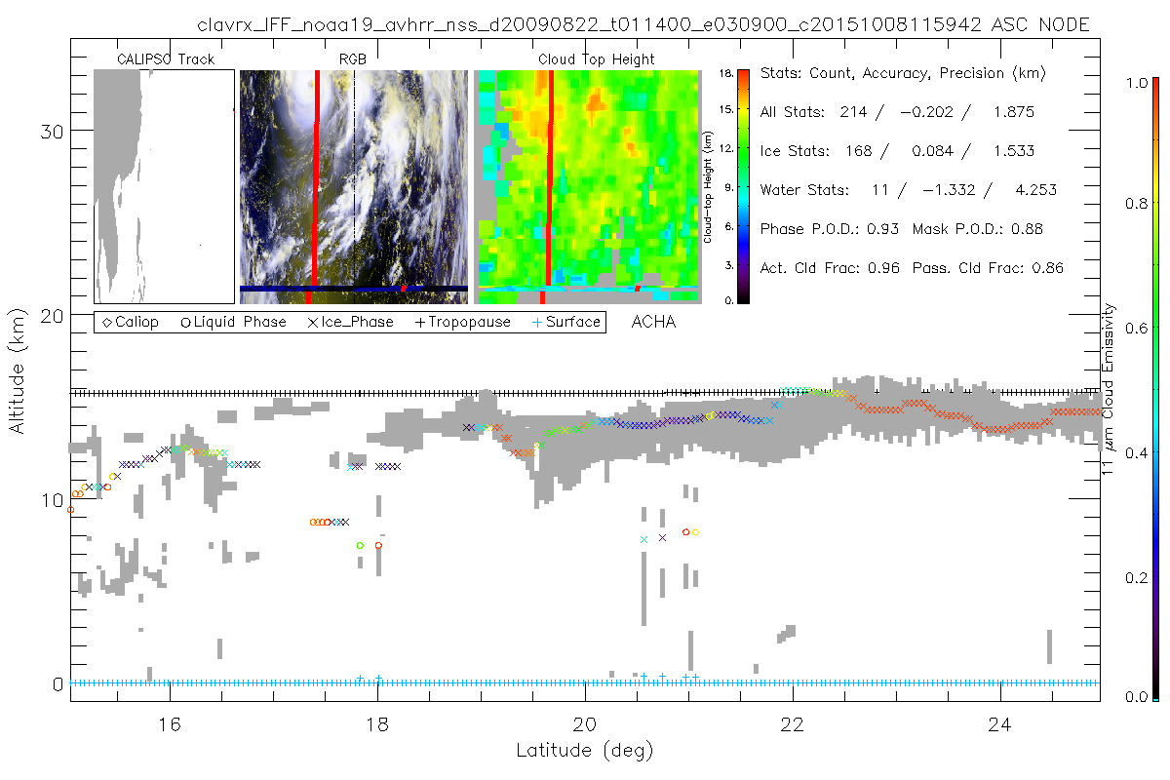

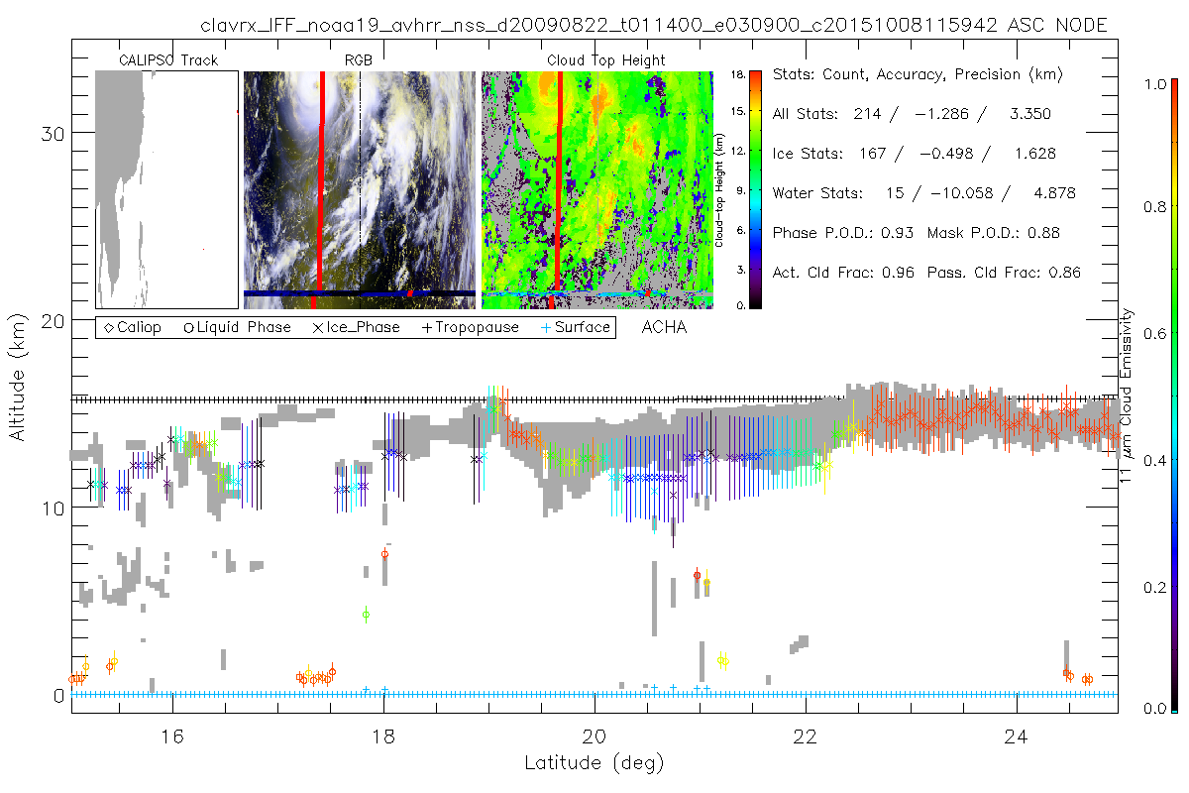
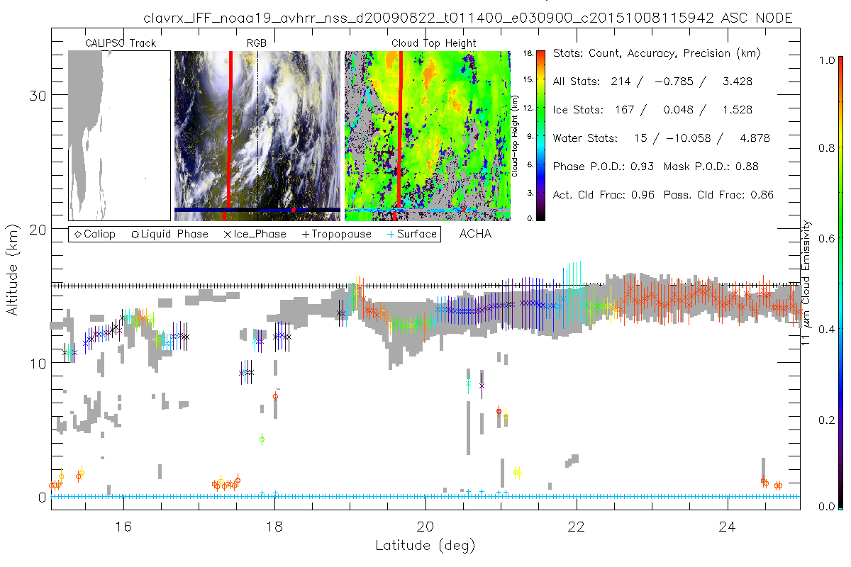
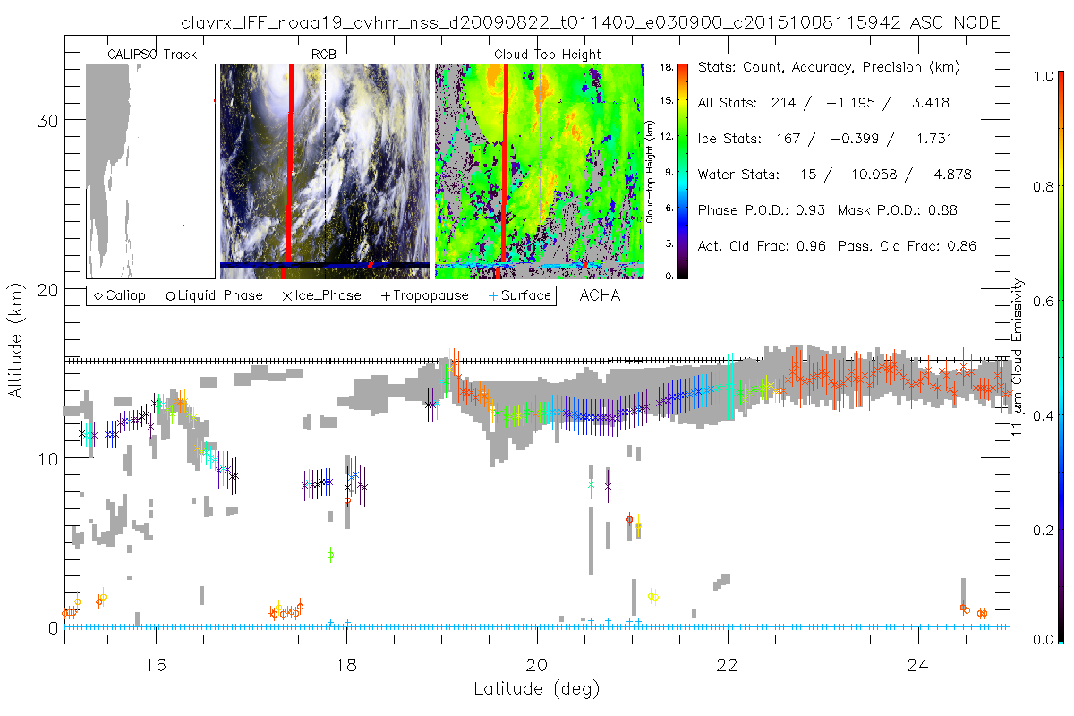
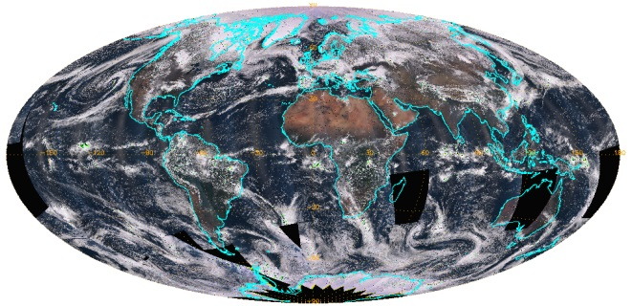
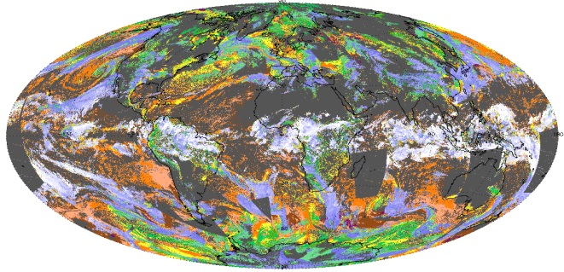
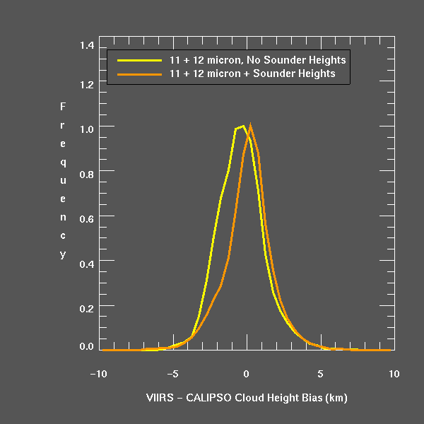
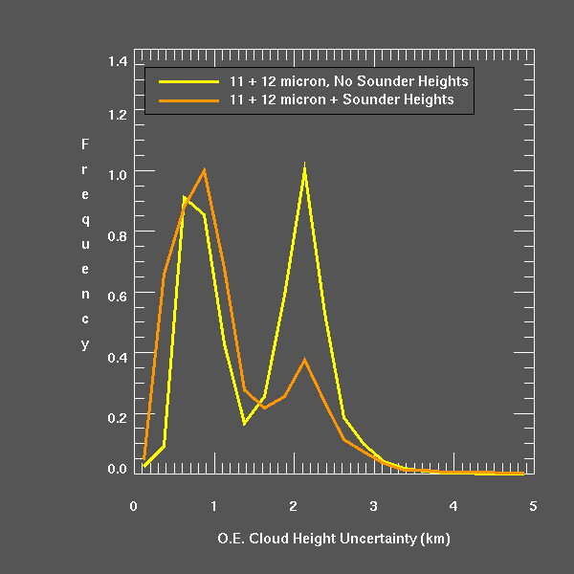
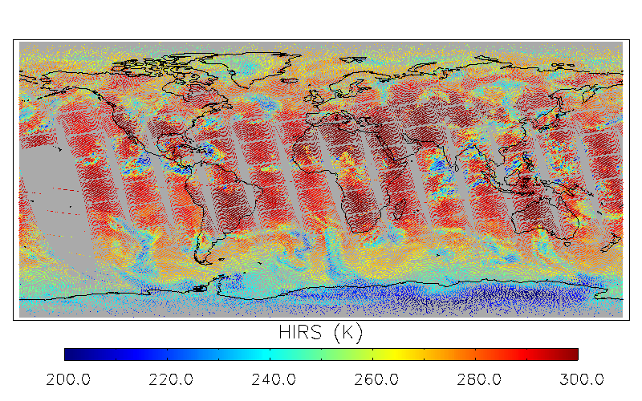
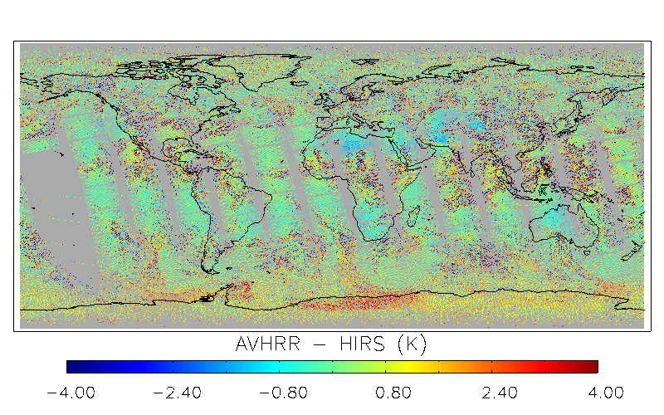
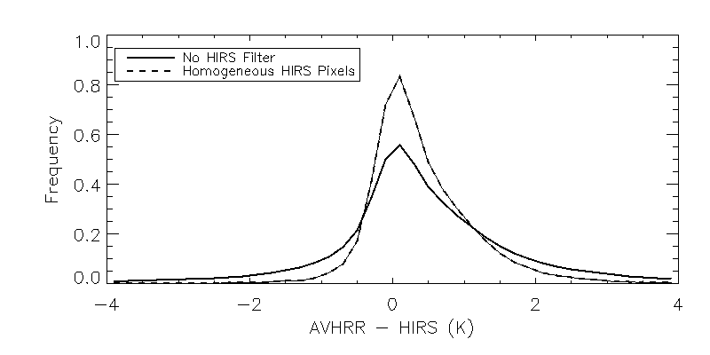


Merger of Imager and Sounder Data for Improved Cloud Height Estimation
8p.07
Andrew Heidinger, Denis Botambekov, Mike Foster, Mike Hiley,Yue Li, Andi Walther and Steve Wanzong
Center for Satellite Applications and Research (STAR), NOAA / NESDIS, Madison, WI, USA
Cooperative Institute for Meteorological Satellite Studies, University of Wisconsin-Madison
ITOVS Science Conference 2015
What Are We Doing
CLAVR-x is the NOAA/NESDIS Operational Processing System for AVHRR and serves as the driver for the PATMOS-x Climate Data Records. It is part of the CSPP Package (VIIRS, MODIS, AVHRR)
CLAVR-x was modified to read the HIRS/AVHRR and VIIRS/CrIS data generated at UW/SSEC.
We have developed techniques to improve imager (AVHRR or VIIRS) cloud heights with the spectral information from the sounder (HIRS or CrIS).
Cloud height estimation can be accurately accomplished with channels in IR absorption bands such as the 7 μm H₂O and 14 μm CO₂ bands.
We recreate MODIS 7μm H2O or 14 μm CO₂ Bands from the Sounder Channels and co-locate them within each imager pixel.
We exploit the Sounder’s spectral information to improve cloud height while maintaining the high spatial resolution offered by the Imager.
Why are we doing this?
Current and some future polar orbiting imagers do not have IR absorption channels but will fly next to IR sounders which provide this data at coarser spatial resolutions.
Ability to estimate cloud height from satellites is important for climate and real-time remote sensing.
Doing this on AVHRR/HIRS and continuing on VIIRS/CrIS will provide a spectral baseline that can be extended for many decades into the future.
While sounder heights are accurate, many cloud features exist at spatial scales too fine to be resolved by sounders
Some applications - like Winds - rely on tracking small scale features and cloud edges which are not resolved by sounders. This method is ideally suited for this application.
Interpolation of Sounder to Imager resolution
Case: Hurricane Bill 2009-08-19 around 17UTC. NOAA19 and AQUA MODIS using interpolation scheme (2)
The Problem:
Sounder footprints (HIRS or CrIS) are large compared to the imager footprints (AVHRR or VIIRS)
Large spatial gaps can exist between sounder footprints. (i.e. HIRS/4)
HIRS/3 (NOAA-17 and earlier) has 20km footprint spaced every 20km, compared to AVHRR GAC resolution of 4km. HIRS/4 (NOAA18/19 and METOP-A/B has even lower spatial coverage, with a smaller 10km footprint and still 20km between footprints.
Possible ways to deal with it:
(1) Simple nearest neighbor interpolation.
(2) Leverage that AVHRR and HIRS both have 11μm channel to develop simple, improved interpolation algorithm. Here is the algorithm for the results shown below:
  For each AVHRR pixel that is not covered by a HIRS observation:
    Of the 4 nearest HIRS observations, choose the one with the smallest (AVHRR 11μm – HIRS 11μm) difference.
    Mask out AVHRR pixels that are greater than some distance from a HIRS observation, to stop interpolation at edge of swath and in HIRS calibration lines.
Does it work?
We think it is promising in clear-sky areas and allows application of some important clear-sky detection tests.
We are exploring if it is useful in cloudy situations.
Can compare to overlapping MODIS orbits to get a visual sense of how the interpolation behaves on channels that AVHRR lacks (CO₂ and water vapor bands). See Images to the right.
We will also compare the 13.3 μm results to those from the Fusion Approach (Gladkova et al.).
Method to Improve Imager Heights with Sounder Observations.
Assumptions
  IMAGER cloud heights are accurate for boundary layer and optically thick ice clouds
  SOUNDER is more accurate for optically thin cirrus.
  Optically thin cirrus heights do not change rapidly
  Method
  We select SOUNDER CO₂ slicing cloud heights for optically thin cirrus (middle image)
  We spatially interpolate the SOUNDER values to the surrounding IMAGER pixels.
  We use the interpolated SOUNDER values as the a priori constraint in the IMAGER optimal estimation cloud height routine.
Imager False Color RGB
Imager Cloud Type
Sounder Cloud Height (Menzel HIRS)
Imager Cirrus Height from Sounder Values
Imager Cloud Height using Sounder as new prior constraint in O.E. (NOAA ACHA Alg.)
HIRS/AVHRR Case Study Comparisons of Cloud Heights to CALIPSO/CALIOP for August 22, 2009. ACHA is the NOAA Enterprise Algorithm. On AVHRR, Cloud Height is derived from 11 and 12 μm channels.
Imager Cirrus Background Heights from Spatially Interpolated HIRS Results (Menzel NCEI HIRS Project)
Imager Cirrus Background Heights from CO₂ Slicing Applied to HIRS CO₂ channels. (Should be similar to Menzel results and these values are used for VIIRS/CrIS)
Results from ACHA on AVHRR without any HIRS influence, Vertical lines are the O.E. uncertainties.. Note the growth of the O.E uncertainties and decrease in height performance for very thin cirrus..
Results from ACHA using the Cirrus Background from the Menzel HIRS products. Note IMPROVED PERFORMANCE and REDUCED UNCERTAINTIES
Results from ACHA using the Cirrus Background from a CO₂ Slicing algorithm applied to HIRS CO₂ channels in CLAVR-x. Similar benefits seen though difference in CO2 cirrus height backgrounds evident.
cloud layer product
HIRS CO₂ Slicing from Menzel et al.
CLAVR-x CO₂ Slicing
ACHA + No Sounder
.
ACHA + Menzel CO₂ Slicing
ACHA + CLAVR-x CO₂ Slicing
VIIRS/CrIS Global Analysis
SNPP March 29, 2013
Calibration Opportunities
The PATMOS-x team has spent much effort in improving the AVHRR solar reflectance channels
The PATMOS-x AVHRR IR calibration remains the Pathfinder Calibration from the 1990’s.
Recently, the NCEI program has supported new HIRS IR calibration
Having HIRS data co-located with AVHRR allows us to check and perhaps improve the AVHRR IR Calibration.
This will be folded into our WMO SCOPE-CM Effort.
Comparison of Orbital Variations in HIRS and AVHRR 11 μm BT difference. Sun angle plotted for reference. NOAA-19 Top and NOAA-07 bottom.
Thank You !
JPSS Risk Reduction Program.
NCEI Climate Data Records Program
JPSS CAL/VAL Program
Paul Menzel and Rich Frey
Same analysis applied above to AVHRR/HIRS is applied to SNPP VIIRS/CrIS.
Results confirm those from case study.
Modest reduction of height bias
Large reduction in height uncertainty
cloud pressure
true color
Comparison of HIRS and AVHRR 11 μm BT on NOAA-19 ascending node. AVHRR BT computed from mean radiance in each HIRS FOV.

